Slide 1
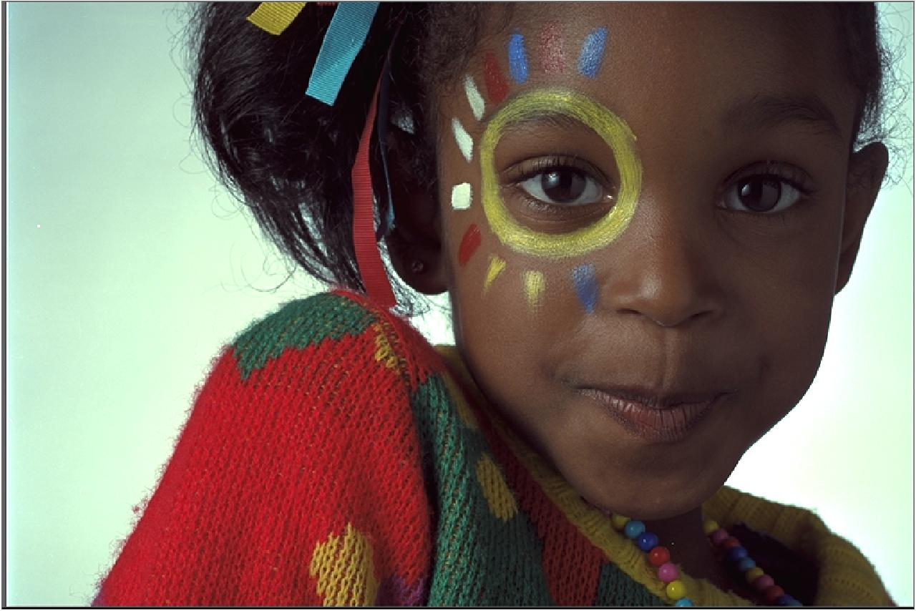
Sender: Original RGB image

Slide 2
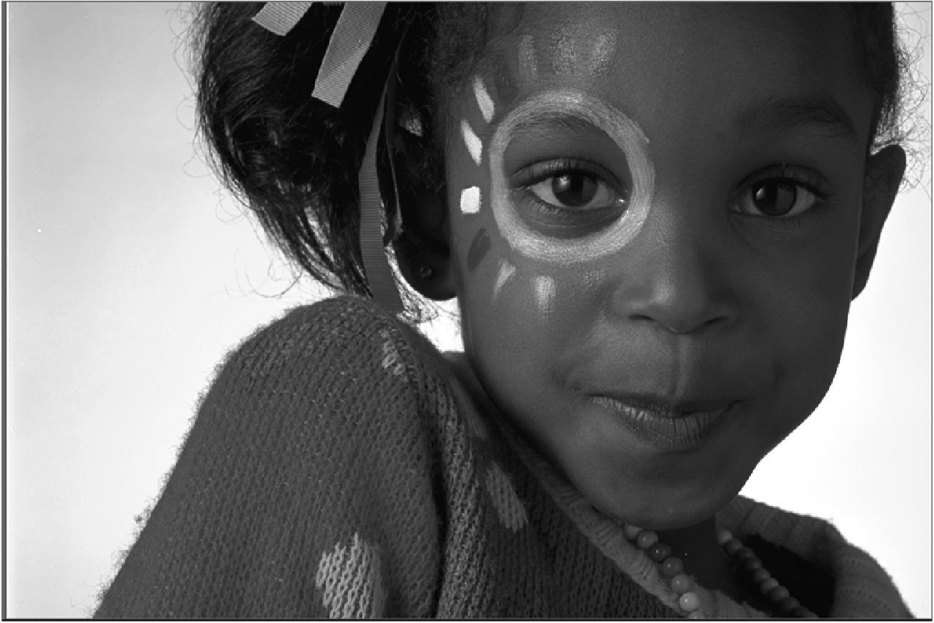
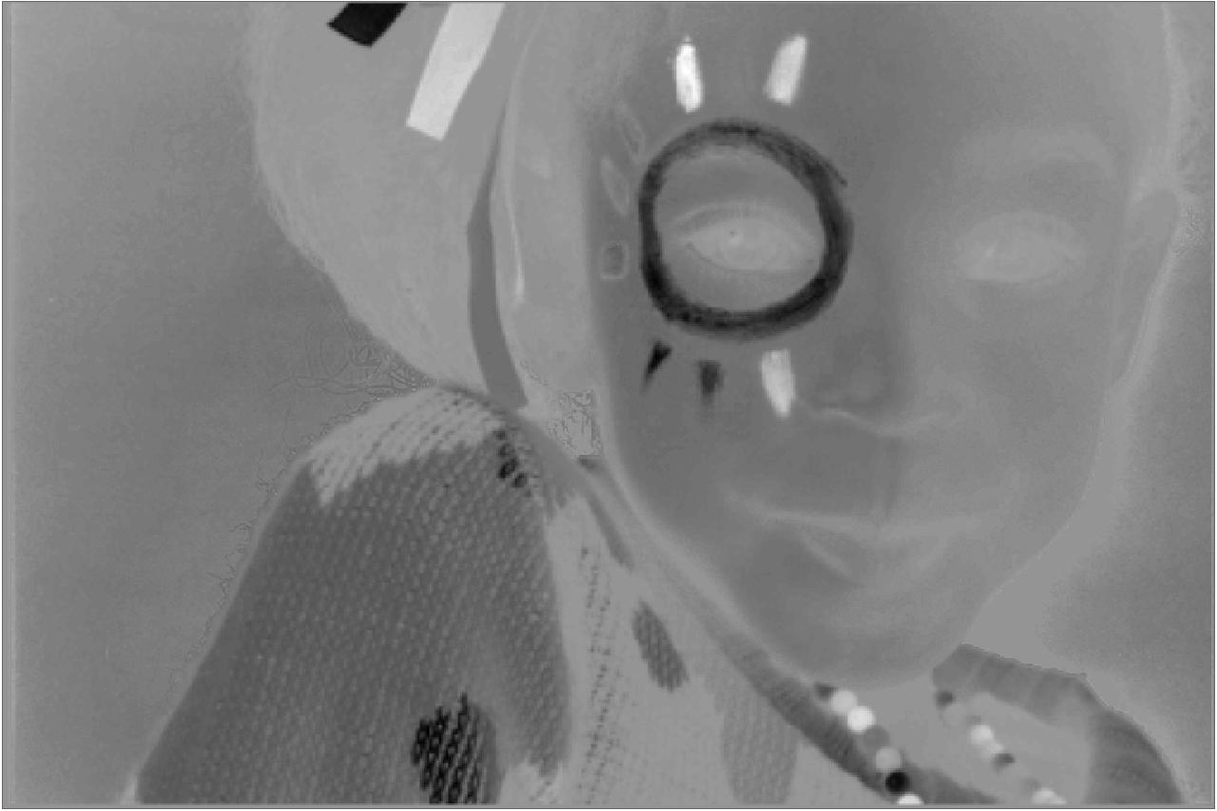
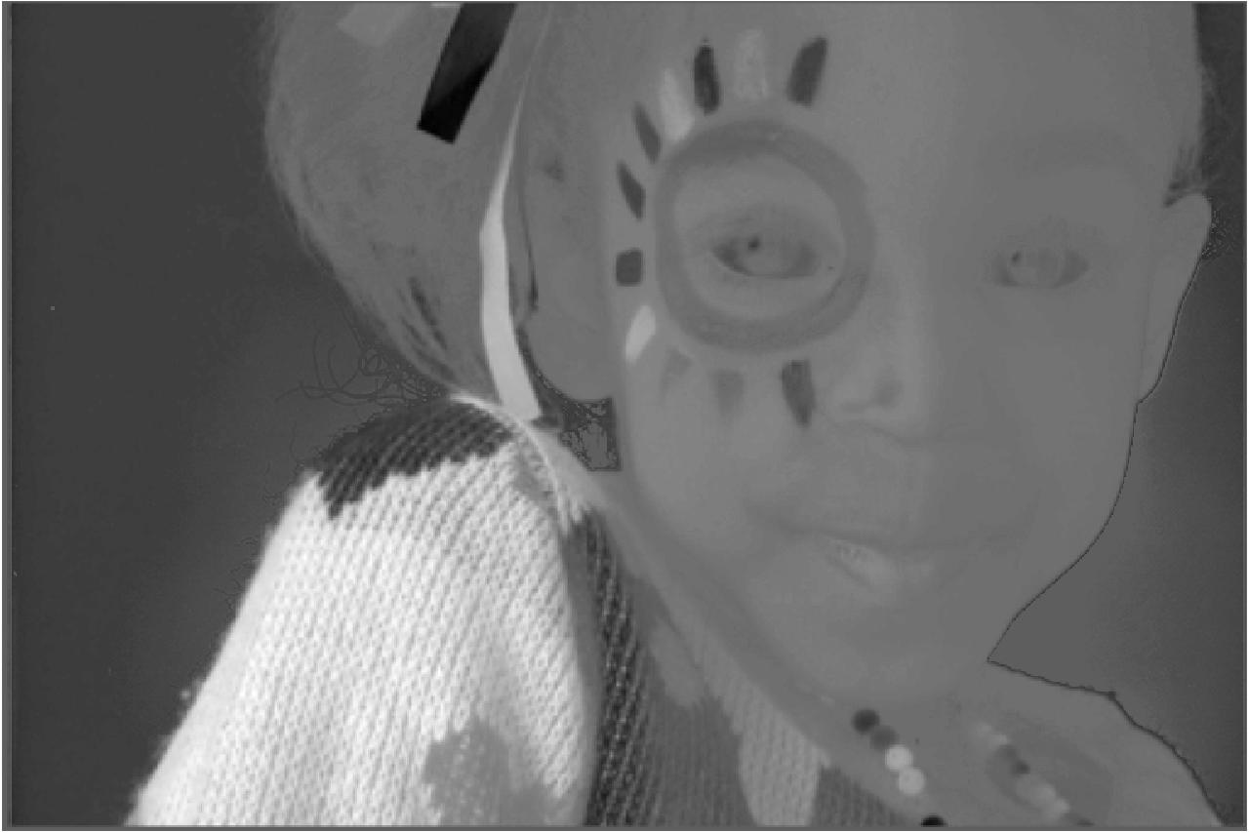
Sender: YCbCr

Slide 3
Sender: YCb2Cr2

Slide 4
Receiver: YCb2Cr2

Slide 5
Receiver: YCb*Cr*

Slide 6
Receiver: Approximation of original RGB image

