Slide 1
A Supplemental Instruction Model for Precalculus
Gabriela Schwab
El Paso Community College
Helmut Knaust
Emil Schwab
The University of Texas at El Paso
Department of Mathematical Sciences

Slide 2
EPCC Student Population Profile
EPCC is the second largest Hispanic-serving community college in the nation.
More than 24 000 credit students
88% Hispanic
60% female
61% part-time students

Slide 3
Main Challenge
Incoming students are often not well-prepared for studying STEM disciplines
The two Precalculus courses often serve as roadblocks for incoming students:
Low pass rates
High drop rates

Slide 4
We currently have funding from the U.S. Department of Education’s MSEIP program to provide students in Precalculus I and II with Supplemental Instruction (SI), to enhance student achievement in these high-risk courses through collaborative learning techniques.
The main focus of our project is to enrich the students’ learning experience in these two courses by adding mandatory Supplemental Instruction workshops as an integral part of the courses, led by UTEP graduate students.

Slide 5
The new delivery format includes more Peer-led Learning:
Precalculus I
Precalculus II
Three hours lecture per week
One section
30-35 students
Four hours lecture per week
One section
30-35 students
+
+
One hour Supplemental Instruction per week;
Three sections with
10-12 students each
One hour Supplemental Instruction per week;
Three sections with
10-12 students each

Slide 6
Supplemental Instruction (SI)
What is SI?
What are SI leaders?
Our SI leaders are graduate students from UTEP, extensively trained to help students learn the mathematics in the course.
The SI leaders attend classes together with their students, read assigned materials, take class notes, and conduct regularly scheduled SI sessions.
The SI leaders, rather than acting as lecturers or teachers, facilitate and encourage student groups to process the material and solve mathematical problems.
SI targets high-risk courses instead of high-risk students.
SI is mandatory for all students in the class; it is integral to the course.
SI is active learning in small size sections, group-based, led by an SI leader; it is not an additional lecture, a study- group, or tutoring.
SI is dynamic, interactive, argumentative and engaging.
SI begins in the first week of class before students encounter academic problems.

Slide 7
Differences between SI and other forms of Academic Support
SI Leaders attend class lectures to remain knowledgeable about the course material, to maintain communication with the course professor, and to model effective student behavior.
SI Leaders involve students actively in learning the course material through group discussion, problem solving, practice tests, creating and completing study guides, and other active learning techniques. SI sessions are not just Q&A test reviews where students are typically more passive.

Slide 8
SI Leaders demonstrate effective study strategies and engage students in practicing note-taking, anticipating test questions, and foster vocabulary development and memory aids. This helps students develop deeper levels of thinking and reasoning skills.
The SI Leaders and the SI program are evaluated each semester to maintain program quality and assess outcomes of SI on course grades and student retention.

Slide 9
Benefits of the SI Program to Students
SI is an efficient and effective use of a student’s available time to study.
Students have access to study assistance from a peer who has done well in the course and with whom they may feel more comfortable than the course professor. Thus, students who may not seek assistance from their professor still have a source for assistance to do well in the class.
Students benefit from reviewing material with other students and developing study partnerships that can be maintained beyond the completion of the class.
Instructors whose courses include SI are particularly aware of students’ needs and work closely with the SI leader to help students succeed in the course.

Slide 10
Benefits of the SI Program to EPCC
SI supports faculty who teach Precalculus I+II classes that are often too large to allow personal attention to students. SI leaders help the professor maintain high academic standards and expectations for their students.
SI attendance raises the academic performance of students, which reduces course withdrawal and failure rates.
SI provides support to students in pre-major core classes, which promotes increased passing grades. Improved course grades promote entry and retention rates in college major programs.
SI sessions provide for more in-depth exploration of course material for which there may not be sufficient time in class.

Slide 11
SI Leaders’ Specific Responsibilities
Time Commitment: 20 hours per week
6 Hours – Teaching the SI workshops
6 Hours – Attending the class lectures and meeting with the course instructor
5 Hours - Preparation
2 Hours - Office Hours
1 Hour – Meeting with the Project Directors

Slide 14
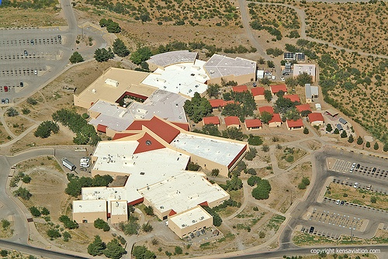
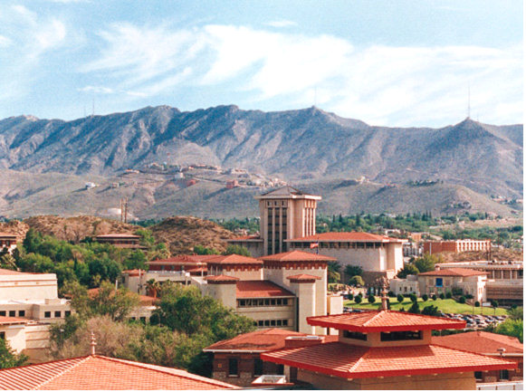
Contacts
Gabriela Schwab
gschwab@epcc.edu
Helmut Knaust hknaust@utep.edu
Emil Schwab
eschwab@utep.edu
EPCC Transmountain Campus
UTEP Campus

