Slide 1
Cross Institutional Implementation of Supplemental Instruction (SI)
Gabriela Schwab
El Paso Community College
Emil Schwab
Helmut Knaust
Alexandra Bogdan
Oscar Macedo
The University of Texas at El Paso
Department of Mathematical Sciences

Slide 2
EPCC Student Population Profile
EPCC is the second largest Hispanic-serving community college in the nation.
More than 24 000 credit students
88% Hispanic
60% female
61% part-time students

Slide 3
Main Challenge
Incoming students are not well-prepared for studying STEM disciplines
The two Precalculus courses often serve as roadblocks for incoming students:
Low pass rates
High drop rates

Slide 4
We currently have funding from the U.S. Dept. of Education (MSEIP program) to provide students in Precalculus I and II with Supplemental Instruction (SI), to enhance student achievement in high-risk courses through collaborative learning techniques.
The main focus of our project is to enrich the learning experience in these two courses by adding mandatory Supplemental Instruction as an integral part of the courses, led by UTEP graduate students.

Slide 5
The new delivery format includes more Peer-led Learning:
Precalculus I
Precalculus II
Three hours lecture per week
One section
30-35 students
Four hours lecture per week
One section
30-35 students
+
+
One hours Supplemental Instruction per week;
Three sections with
10-12 students each
One hours Supplemental Instruction per week;
Three sections with
10-12 students each

Slide 6
Supplemental Instruction (SI)
What is SI?
What are SI leaders?
SI leaders are graduate students from UTEP, extensively trained to help students learn the mathematics in the course.
SI leaders attend classes together with their students, read assigned materials, take class notes, and conduct regularly scheduled SI sessions.
SI leaders, rather than acting as lecturers or teachers, facilitate and encourage the student group to process material and solve mathematical problems.
SI targets high-risk courses instead of high-risk students.
SI is mandatory for all students in the class; it is integral to the course.
SI is active learning in small size sections, group-based, led by an SI leader; it is not an additional lecture, a study- group, or tutoring.
SI is dynamic, interactive, argumentative and engaging.
SI begins in the first week of class before students encounter academic problems.

Slide 7
Description of the SI Program
The SI program is implemented in Precalculus I+II courses and is designed to help students succeed in these difficult academic courses.
These are courses that have been identified with a significant rate of D and F grades as well as withdrawals.
SI targets “high risk” courses, not “at risk” students.
SI assistance is provided in one hour lab sessions with small groups of students, and it is not a class review session.

Slide 8
SI leaders are graduate students who have successfully completed the course. Their academic ability is reflected in their G.P.A.; they have demonstrated understanding of effective study strategies and behaviors. SI leaders are assigned to two/three courses and they are teaching 6 hours of labs /week.
SI leaders attend all class sessions, take notes, read assigned material, and model effective in-class behavior.
SI leaders are trained. They are required to attend regular training each semester and are observed and evaluated throughout each semester.

Slide 9
SI leaders use collaborative teaching techniques to involve students in discussing, exploring, and understanding course material. They demonstrate, model, and involve students in practicing effective study strategies. They may also use Webassign during lab sessions.
SI sessions help professors maintain high standards and expectations for a course, especially in situations where class size prevents a professor from giving personal attention to individual students.

Slide 10
SI Leaders (Fall 2009)
NW Campus: Persis Beaven & Oscar Macedo
RG Campus: Olivia Baciu, Alexandra Bogdan
& Oscar Macedo
TM Campus: Tami Dashley, Melissa Pugh
& Jessica Reyes

Slide 11
Differences between SI and other forms of Academic Support
SI Leaders attend class lectures to ensure understanding of course material, to maintain communication with the course professor, and to model effective student behavior.
SI Leaders involve students actively in learning course material through group discussion, problem solving, practice tests, creating and completing study guides, and other active learning techniques. SI sessions are not just Q&A test reviews where students are typically more passive.

Slide 12
SI Leaders demonstrate effective study strategies and engage students in practicing note-taking, anticipating test questions, and foster vocabulary development and memory aids. This helps students develop deeper levels of thinking and reasoning skills.
SI Leaders and the SI program are evaluated each semester to maintain program quality and assess outcomes of SI on course grades and student retention.

Slide 13
Benefits of the SI Program
Benefits to Students
Benefits to EPCC
SI is an efficient, effective use of a student’s available time to study.
Students have access to study assistance from a peer who has done well in the course and with whom they may feel more comfortable than the course professor. Thus, students who may not seek assistance from their professor still have a source for assistance to do well in the class.
SI supports faculty who teach Precalculus I+II courses that are often too large to allow personal attention to students. SI leaders help the professor maintain higher academic standards and expectations for their students.
SI attendance raises the academic performance of students, which reduces course withdrawal and failure rates.

Slide 14
Students benefit from reviewing material with other students and developing study partnerships that can be maintained beyond the completion of the class.
Professors whose courses include SI are particularly aware of students’ needs and work closely with the SI leader to help students succeed in the course.
SI provides support to students in pre-major core classes, which promotes increased passing grades. Improved course grades promote entry and retention rates in college major programs.
SI sessions provide for more in-depth exploration of course material for which there may not be sufficient time in class.

Slide 15
SI Leader Specific Responsibilities
Time Commitment: 20 hours per week
6 Hours - Teach Labs
6 Hours – Attend lecture and discussions/meetings with the instructor
5 Hours - Preparation /grading lab quizzes
2 Hours - Office Hours
1 Hour – Meeting with Project Directors

Slide 16
Responsibilities for Planning
Responsibilities in Class
Take thorough notes of all lectures.
Communicate with the professor about SI sessions, as needed.
Prepare organized, effective SI sessions.
Incorporate collaborative and active learning techniques.
Create study materials to aid students in learning course material.

Slide 17
Responsibilities During SI Sessions
Create a comfortable learning environment during SI sessions.
Ensure students actively participate in the learning process.
Incorporate study skills such as textbook reading, note taking, and test preparation and test taking skills.
Use a variety of teaching methods.
Implement ideas learned during SI training.
Take roll during each SI session.

Slide 18
Administer quizzes during SI sessions, and maintain an accurate grade record.
Use Webassign during lab sessions, if needed.
Plan the SI sessions according to the need of each particular group of students.
Follow instructions from the instructor about the type of assignments you should give/work with the students.

Slide 19
Thank You
and
Have a Great Semester!

Slide 20
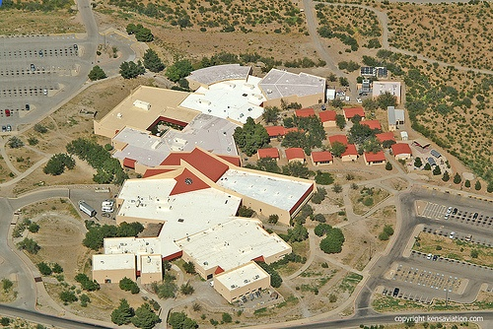
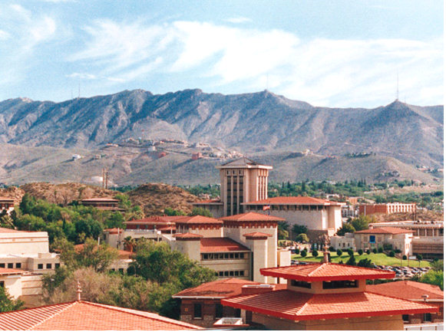
Contacts
Gabriela Schwab
gschwab@epcc.edu
Helmut Knaust hknaust@utep.edu
Emil Schwab
eschwab@utep.edu
EPCC Transmountain Campus
UTEP Campus

