Slide 1
Work in Progress: The Bridge to the Doctorate Experience A Reflection on Best Practices and Project Outcomes
T. Aktosun (UT Arlington)
Arciero, B. Flores, H. Knaust (UT El Paso)
C. Villalobos (UT Pan American)
Rapid City SD, October 13, 2011

Slide 2
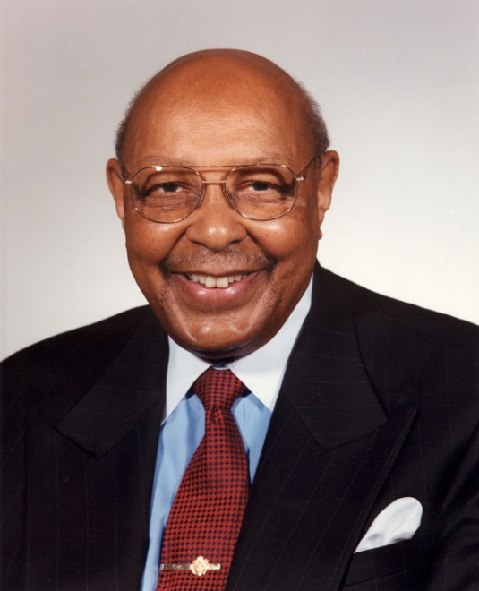
The UT System Louis Stokes Alliance for Minority Participation (LSAMP)
• National Science Foundation (NSF) funding since 1992
• The University of Texas System Alliance consists of
Nine universities (UT Arlington, UT Austin, UT Brownsville,
UT Dallas, UT El Paso, UT Pan American, UT Permian Basin,
UT San Antonio, and UT Tyler), and
• Five community colleges (El Paso Community College,
Howard College, Midland College, Odessa College,
San Antonio College)
• About 1,500 STEM at these campuses students have
participated as LSAMP Research Scholars
• The Proven Method: Undergraduate Research
Louis Stokes, J.D.

Slide 3
LSAMP Bridge to the Doctorate
In 2002, the NSF started funding of LSAMP Bridge to the Doctorate (BD) programs.
Goal: To provide funding for LSAMP scholars for their first two years in a graduate program.
Each Bridge to the Doctorate Initiative consists of a cohort of twelve students at one LSAMP Alliance institution.

Slide 4
LSAMP Bridge to the Doctorate
Each BD scholar receives
A stipend of $30,000 per year
Full payment of tuition and fees
A book allowance
Lab supply funding
Travel support

Slide 5
UT LSAMP Bridge to the Doctorate
The UT System Alliance has received funding from the NSF for seven cohorts:
Five cohorts at UT El Paso (2003-05, 2005-07,
2008-10, 2009-11, 2011-13)
One cohort at UT Pan American (2004-06)
One cohort at UT Arlington (2010-12)
Campus | Females | Males | URMs | Non-URMs
UT El Paso | 20 | 26 | 41 | 5
UT Pan American | 10 | 2 | 9 | 3
UT Arlington | 6 | 6 | 8 | 4

Slide 6
Selecting the BD Scholars I
Extensive Recruitment
Locally (among students and faculty)
Nationwide among other LSAMP Alliances
Goal: Creating a sufficiently large pool of applicants
Two recruitment periods (Summer and Fall)

Slide 7
Selecting the BD Scholars II
Application material (requirements similar to the NSF Graduate Research Fellowship program)
Cover letter
Resume
Transcript(s)
Statement of Purpose
Two letters of recommendation
Proposal of research work

Slide 8
Selecting the BD Scholars III
Strong candidates are invited to a 30-minute interview with the program directors.
Phone interview is possible.
Selection Criteria:
Strength of academic background
An established student-faculty mentor relationship
Strength of research proposal
Student’s long-term goals & long-term planning; student determination & maturity
Communication skills
“New” graduate students

Slide 9
Selecting the BD Scholars IV
Scholars accepted into the program sign an annual contract
Enrollment in a four-semester weekly BD Seminar
Maintaining full time student status during long and summer semesters
Maintaining a GPA of 3.5/4.0
Satisfactory progress towards degree completion
Participation in one NSF Joint Annual Meeting (professional development)
At least one presentation of scholar’s research at a professional conference per year
Agreeing not to accept other employment

Slide 10
The BD Seminar I
Goals:
Mentoring
Team-Building
Dissemination of information
Improving communication skills (written and oral)
Four-semester sequence starting in the spring semester

Slide 11
The BD Seminar II
Some Activities:
How to pick a faculty mentor
Funding opportunities beyond the BD program
How to apply for grants (guest lecturers)
Research papers
Academic and research misconduct
Post-Docs (guest lecturer, former LSAMP BD student)
How to apply for academic jobs
How to get tenure
“Ice cream socials”
“Challenge course”

Slide 12
The BD Seminar III
Deliverables:
Research power point presentations (1st and 3rd semester)
Laboratory visits (2nd semester)
Write a CV
Write a grant proposal summary

Slide 13
2009-11 Cohort Progress Report
Total of 13 students
5 students are in a fast-track Ph.D. program.
5 students have completed a MS degree.
3 students are currently enrolled in a Ph.D. program.
1 student plans to enroll in a Ph.D. program.
1 student accepted employment.
2 students are pursuing a MS degree with plans to continue in a Ph.D. program.
1 student stopped out.

Slide 14
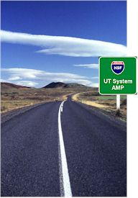
Contact Info
Helmut Knaust
Department of Mathematical Sciences
The University of Texas at El Paso
El Paso TX 79968-0514
hknaust@utep.edu
http://lsamp.utep.edu
http://helmut.knaust.info/BD

