Slide 1
Peer-Led Team Learning in Precalculus
Helmut Knaust
Department of Mathematical Sciences
The University of Texas at El Paso (UTEP)
August 2, 2012

Slide 2
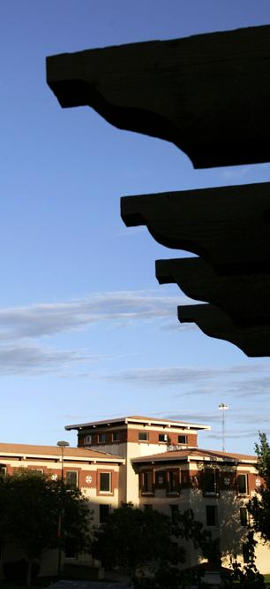
Overview
A Personal Note
UTEP Profile
Peer Leaders in Pre-Calculus
Peer Leader Training
UTEP Campus

Slide 3
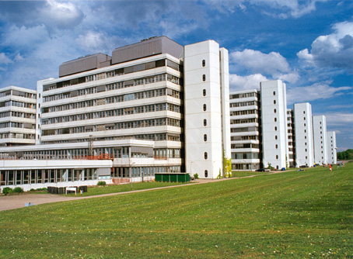
Studying Mathematics
Freshman in 1974:
Both Analysis and Linear Algebra were taught using (undergraduate) peer leaders
Junior in 1976:
Peer leader for Analysis (4 hours per week)
University of Bielefeld (Germany)

Slide 4
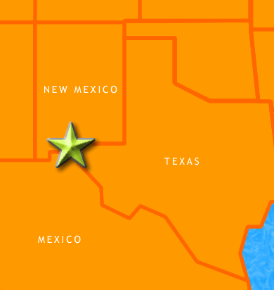
Students in Science and Engineering at UTEP
Engineering: 3,149
Science: 2,601
Total: 5,750
Total at UTEP: 22,600
(UG 84%, GR 16%)
Source: CIERP, Fall 2011

Slide 5
UTEP Student Population Profile
24 years of age (undergraduate average)
77% Hispanic
54% female
84% from El Paso County commuting daily
63% full-time students
84% employed
50% first generation university students
Source: CIERP, Fall 2010 (mostly)

Slide 6
UTEP’s Main Challenges
Incoming students are not well-prepared for studying STEM disciplines
Low retention rates
Low graduation rates
Long time to graduation

Slide 7
Precalculus Setup
UTEP has no College Algebra course.
Non-Stem majors take the Mathematics for Social Science course or the terminal course Mathematics in the Modern World.
STEM majors take a 5-hour Precalculus course.
The course is a combination of College Algebra and Trigonometry.
The Precalculus course is offered in four formats:
Four hours lecture plus two hours PLTL (about 50 students) [450-750 students total]
Five hours lecture (evening classes, about 50 students) [100]
Online (using ALEKS, large class-size) [100-300]
Engineering learning community sections (with a peer leader, class size about 30 students) [75]

Slide 8
Peer-Led Team Learning at UTEP
Supported by an NSF-STEP Grant*
Used in all introductory Chemistry, Physics and Mathematics classes
Delivery format in Precalculus since Fall 2008 changed to four hours of lecture and two hours of PLTL sessions per week
PLTL sessions (3 sections per course, 15-17 students per session) led by an advanced undergraduate student
* PI: James Becvar, Co-PIs:, Benjamin Flores , Helmut Knaust, Jorge Lopez, and Josefina Tinajero

Slide 9
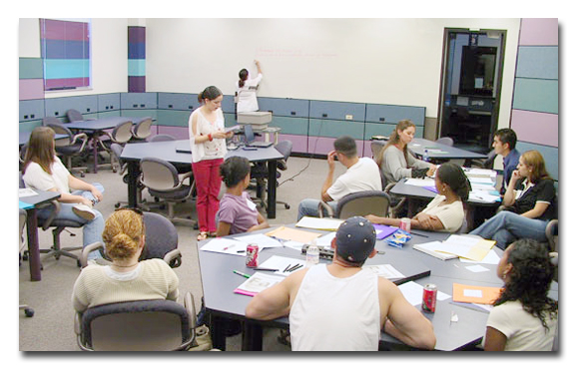
PLTL Principles
PLTL leaders have successfully completed the course.
PLTL leaders work closely with the instructor of the course.
PLTL leaders are trained and supervised before and during the semester.
The PLTL sessions are integral
to the course, cover
challenging problems,
strive to develop student
thinking and encourage
active student learning.

Slide 10
Why Peer Leaders?
Team Learning is student centered.
Peer leaders are approachable.
Peer leaders act as role models.
Peer leaders are highly likely to attend graduate school and/or choose a teaching profession.
“Peer leaders don’t teach,
but help the students learn.”

Slide 11
Selection Procedure
Selection Process
Minimum GPA requirement
Application Form
Interview
Selection Criteria
Leadership Potential
Mathematical Competency

Slide 12
Peer Leader Training
Before the semester – About six hours
Difference between learning and teaching Mathematics
College readiness
What is good teaching in a Mathematics classroom? (Internet videos)
The role of definitions in Mathematics
Questions in the Mathematics classroom
Bloom’s Taxonomy
What works? What doesn’t? (Lessons learned)
“Nuts and bolts” of being a peer leader

Slide 13
Peer Leader Training
During the semester
Peer leaders meet with the course instructor one hour per week.
Peer leaders meet as a group with the supervisor about once every two weeks.
Cookies or chips
Troubleshooting
Enrichment (Logarithmic tables, trigonometry and complex numbers, etc.)

Slide 14
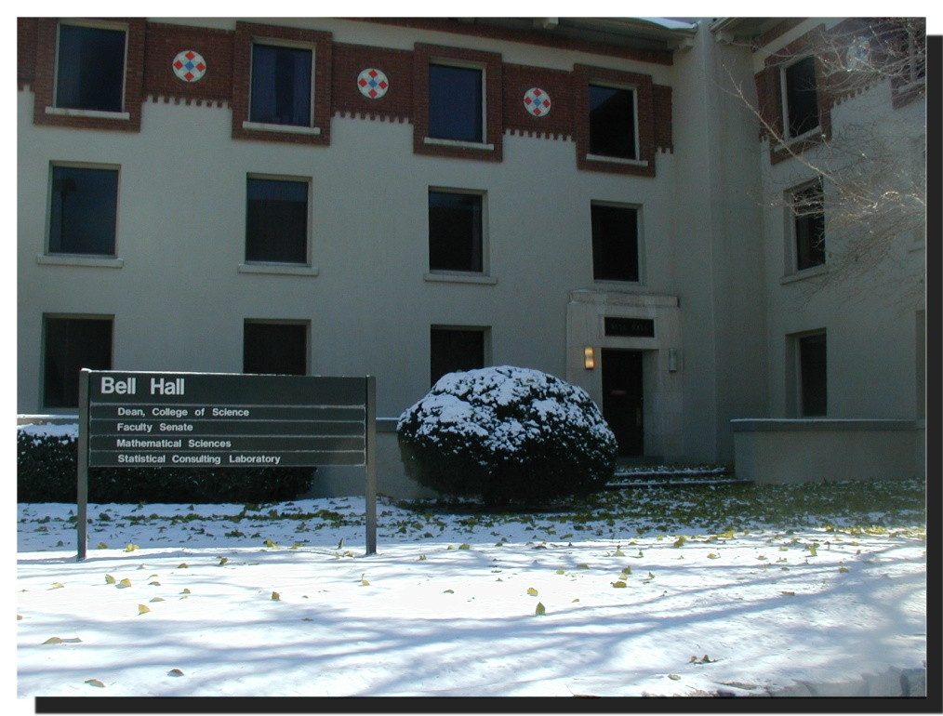
Contact
Helmut Knaust
hknaust@utep.edu
Department of Mathematical Sciences
The University of Texas at El Paso
El Paso TX 79968-0514

