Slide 1
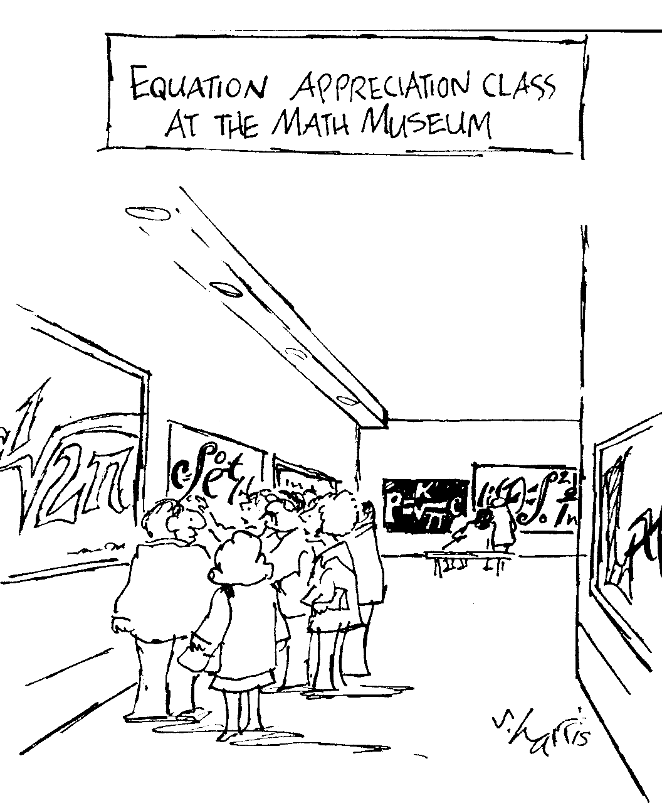
“Math Is Everywhere”
Helmut Knaust
Department of Mathematical Sciences
2012 Summer Orientation

Slide 2
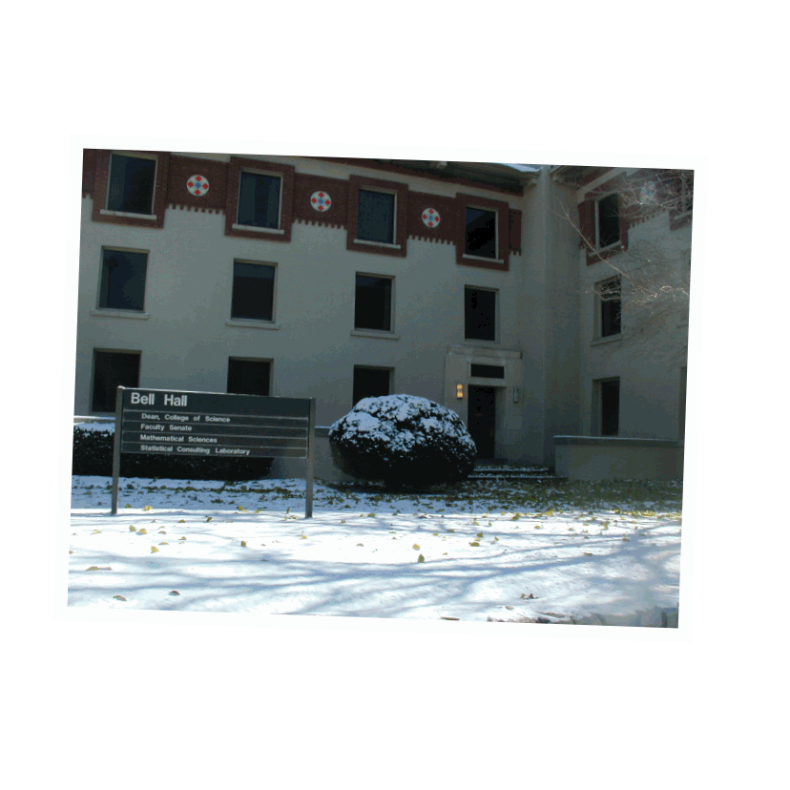
UTEP’s Math Department
24 Professors
The department is offering about 160 courses per semester

Slide 3
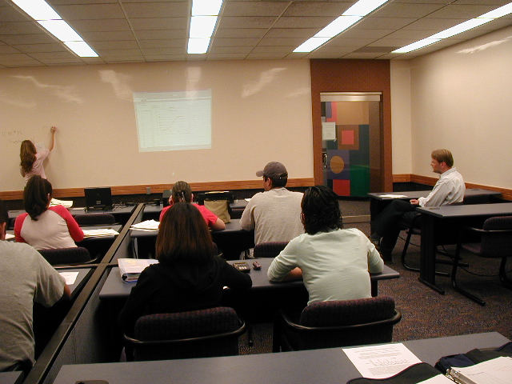
248 Undergraduate Majors
BS in Mathematics,
with various concentrations
43 Graduate Students
MS in Mathematics
MS in Statistics
MAT in Mathematics
Interdisciplinary Programs
MS in Bioinformatics
Ph.D. in Computational Science

Slide 4
Mathematics as a Career
Broad range of positions in
  Business,
  Industry,
  Government,
  and Education
Employers include
  Federal, state and local government,
  Computer and communications industry,
  Oil and energy companies,
  Banks and insurance companies,
  Pharmaceutical and biotechnology companies

Slide 5
Mathematics as a Career
  Federal Agencies hiring Mathematicians include:
    National Security Agency
    Dept. of Health and Human Services
    Dept. of Energy
    Dept. of Defense
    Dept. of Labor
  A Mathematics major is also an excellent preparation for graduate studies in:
    Medicine
    Economics
    Law School

Slide 6
High Job Satisfaction:
Ranked #2: Actuary (Insurance Mathematician)
Ranked #10: Mathematician
Ranked #18: Statistician
Based on five criteria:
1. Income 4. Physical demands
2. Work Environment 5. Stress
3. Employment outlook
Source: http://www.careercast.com/jobs-rated/2012-ranking-200-jobs-best-worst

Slide 7
Mathematics is an ART and a SCIENCE
=
Mathematics is BEAUTIFUL and USEFUL

Slide 8
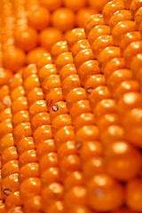
Kepler Conjecture, or How to Pack Oranges as Tightly as Possible

Slide 9
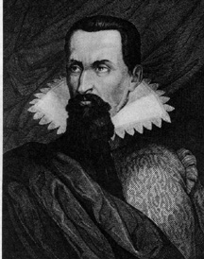
Johannes Kepler conjectured in 1611 that this “hexagonal packing” is the best possible.
The hexagonal packing fills slightly more than 74% of space.
“The packing will be the tightest possible, so that in no other arrangement could more pellets be stuffed into the same container.”
Johannes Kepler (1571-1630)

Slide 10
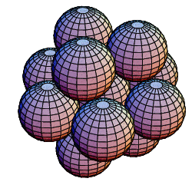
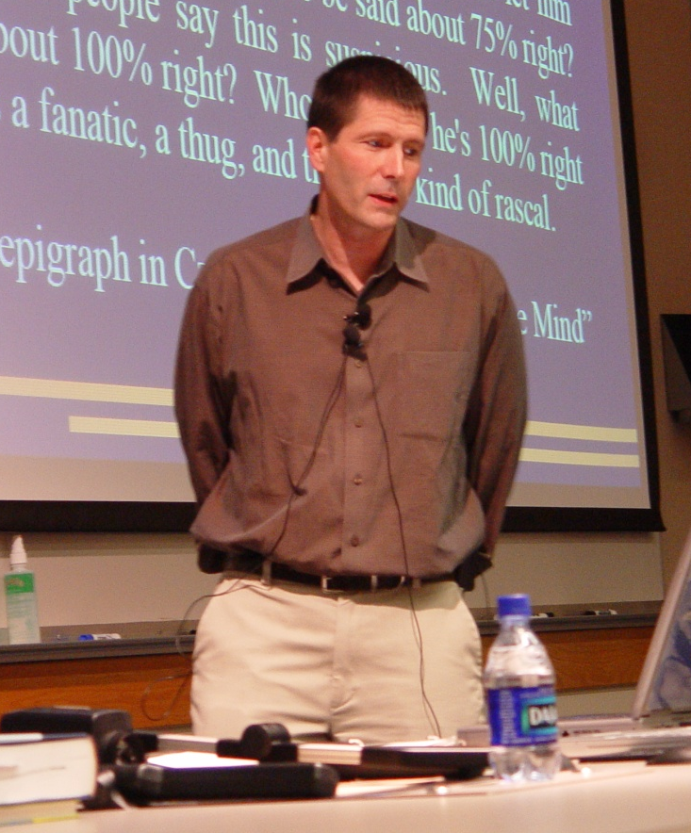
  The Kepler Conjecture was finally proved by Thomas Hales (Univ. of Pittsburgh) in 2002, making extensive use of computer calculations
  Applications of sphere packing to “packing” telephone calls on glass fiber cables
Resource: George G. Szpiro. Kepler’s Conjecture, J. Wiley 2003.

Slide 11
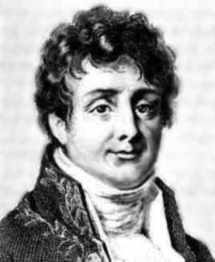
Fourier Series
  In 1807, Joseph Fourier invented Fourier Series to solve the Steady-State Heat Equation, one of the most important equations in Physics.
“Heat, like gravity, penetrates every substance of the universe, its rays occupy all parts of space. The object of our work is to set forth the mathematical laws which this element obeys. The theory of heat will hereafter form one of the most important branches of general physics.”
Joseph Fourier (1769-1830)

Slide 12
A Fourier Series (green) is a sum of trigonometric functions
that approximates a given function (dashed).

Slide 13
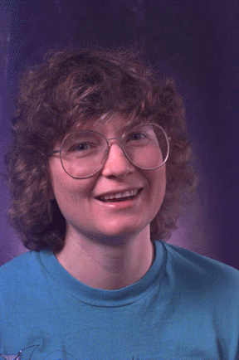
Today the Fast Fourier Transform is the major ingredient for the compression algorithms used in JPEG (images), MP3/4 (sound and video) files.
The new JPEG2000 standard for image compression will use mathematical techniques pioneered by Ingrid Daubechies (Princeton Univ.) and others starting in the 1980s.
Resources: 1. D. Bressoud. A Radical Approach to Real Analysis, MAA 2nd ed 2006.
2. G. Orsak, S. Wood, et al. The Infinity Project, Pearson 2004.

Slide 14
Email:
hknaust@utep.edu
Phone:
(915)747-7002
This Presentation:
helmut.knaust.info/ts.html

