Slide 1
Technology in the Mathematics Classroom
Helmut Knaust
The University of Texas at El Paso
Department of Mathematical Sciences
El Paso TX 79968-0514
hknaust@utep.edu

Slide 2
MATH 5365: Technology in the Mathematics classroom
Is a required three-hour graduate course in
our Master of Arts in Teaching Mathematics
program.
Aimed at current Mathematics teachers and
recent Secondary Education graduates.
Catalog description:
An introduction to technology used in
mathematics education such as graphing
calculators, computer algebra systems,
course specific software and the use of the
internet, and an exploration of its appropriate
and effective use in the mathematics classroom.

Slide 3
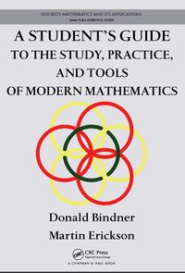
MATH 5365: The CLASS and ITS students
Taught in Spring 2013
Class met one evening per week
24 students:
13 HS teachers
2 MS teachers
3 ES teachers
6 students with no or mimnimal
teaching experience
Textbook:
Bindner/Erickson, A Student’s Guide to the
Study, Practice and Tools of Modern
Mathematics, CRC Press, 2011

Slide 4
MATH 5365: Course Structure
40% Lecture (a lot of Mathematica, some
LaTeX, Geogebra, R)
35% Student presentations
25% In-class activities
Course website:
http://helmut.knaust.info/mediawiki/index.php/CRN_26960
Student comment:
“The course left ample room for self-instruction.”

Slide 5
MATH 5365: STUDENT Deliverables
Software review (2 students each, 20 minutes)
Video lesson (2 students each, 3 minutes)
Technology lesson (2 students each, 30 minutes)
Wolfram Demonstration Project (individual)
Geogebra demonstration (individual)
Homework (individual)
No tests

Slide 6
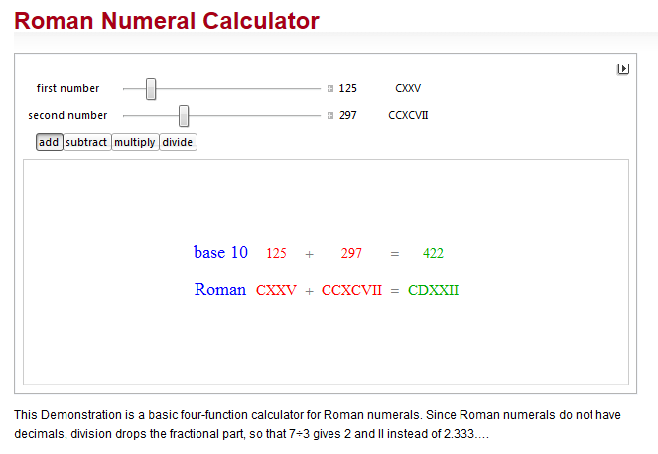
MATH 5365: WOLFRAM demonstration PROJECT
Mathematica has a steep learning curve.
One student project accepted…

Slide 7
MATH 5365: GEoGebra Tube
Everybody loves GeoGebra

Slide 8
MATH 5365: STUDENT Technology Survey I
Results presented only for the 18 teachers
among the students
Devices owned

Slide 9
MATH 5365: STUDENT Technology Survey II
Familiarity with Software
(average to excellent rating)

Slide 10
MATH 5365: STUDENT Technology Survey III
Software/technology “learned on their own”

Slide 11
MATH 5365: STUDENT Technology Survey IV
Software/technology used in the classroom

Slide 12
Helmut Knaust
hknaust@utep.edu
PPT presentation
http://helmut.knaust.info/ts.html
Class website
http://helmut.knaust.info/mediawiki/index.php/CRN_26960

