Slide 1

Image Fusion of satellite images
Jasmine Puente
Brenda Gonzalez
Faculty Advisor : Dr. Helmut Knaust

Slide 2
What is Image Fusion and why is it important?
Process of combining information from two or more images to form a final fused image
We will be using a low resolution multispectral satellite image and a high resolution panchromatic satellite image.
It is more cost efficient
The resulting Multispectral satellite images are used to
  gather agriculture and resource data
  gather information for urban and land development

Slide 3
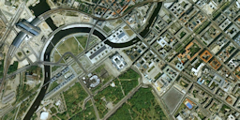
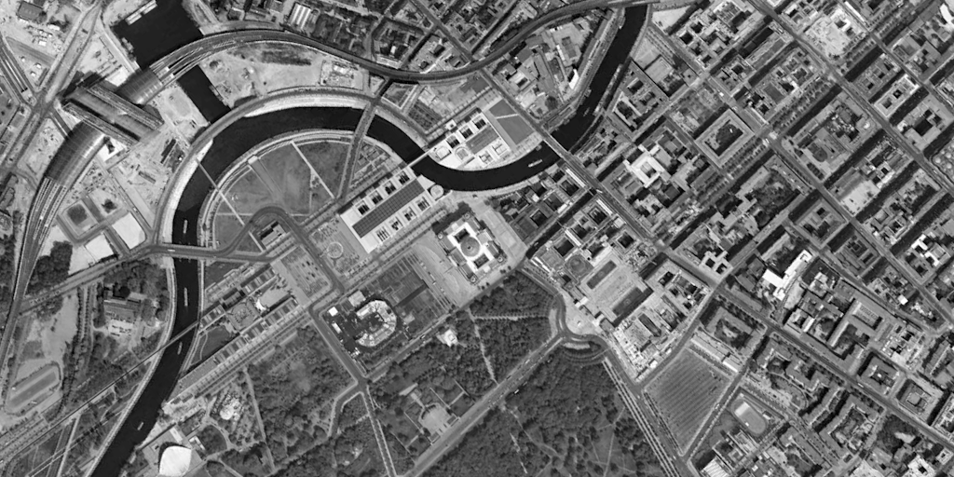
Berlin Satellite Images
256 x 128
1024 x 512

Slide 4
Manipulating Matrices
Images are stored into the computer as large matrices
Each entry corresponding from 0 (black) to 255 (white)
For color images, each entry has a vector containing three entries
We can manipulate the image by manipulating the matrix

Slide 5

Color Transfer Method
Y-Cb-Cr
It is a color space
It is used to encode color images based on human perception
$$Y=219\left(\frac{.299}{255}r+\frac{.587}{255}g+\frac{.114}{255}b\right)+16$$
$$Cb=\frac{224\left(\frac{b}{255}−Y\right)}{1.772}+128$$
$$Cr=\frac{224\left(\frac{r}{255}−Y\right)}{1.402}+128$$

Slide 6
Enlarged the color satellite image and separated it into its luminance and chrominance channels

Slide 7
Discrete Wavelet Transform Method
We used the Haar wavelet.
Applied the Haar wavelet transform to each channel and the grey scale image
Applied multiple iterations to the blur

Slide 8
Due to the blur being downsized, we were limited on the amount of iterations we could compute.
2 iterations

Slide 9
4th Haar Iteration
5th Haar Iteration
6th Haar Iteration
7th Haar Iteration

Slide 10
Discrete Wavelet Frame Transform Method
Applying these filters to the image would not downsize the blur
Blur : applied the low pass filter to the rows and columns
Vertical edges : applied the low pass filter to the rows and the high pass filter to the columns
Horizontal edges : applied the high pass filter to the rows and the low pass filter to the columns
Diagonal edges : applied the high pass filter to the rows and columns

Slide 11
Improvement of spatial characteristics
Peak Signal to Noise Ratio (PSNR)
Measures how similar two images are by comparing each entry
YCbCr PSNR
28.8008 img w/ori

Slide 12
Entropy
Measures length of shortest representation to encode the information
YCbCr Entropy
7.92296 fused image

Slide 13
Preservation of spectral characteristics
Correlation Coefficient
Determines the degree to which two variables are associated
YCbCr correlation coefficient
0.99695 img w/ori

Slide 14
Spectral Discrepancy
Measures the difference in the intensities of the corresponding spectral bands
YCbCr Spectral Discrepancy
7.2278 red channels
6.83007 green channels
7.93516 blue channels

Slide 15
Close-up
Original
4th Haar Iteration
DWFT (15th iteration)
Y-Cb-Cr

Slide 16
Conclusion and Future Research
The DWFT seems to provide the best quality of the fused image
Due to the amount of computations needed to compute the DWFT, it is not as practical as the others.
Further research could include
  Computing more iterations using the DWFT method
  Manipulating the color transfer method by applying discrete wavelet transform methods along with the color transfer methods

Slide 17
Acknowledgments
The National Security Agency (H98230-13-1-0270)
The National Science Foundation(DMS-1156582)
Dr. Helmut Knaust
All of you

Slide 18
Literature Cited
Han, S.S., Li, H.T., Gu, H.Y., 2008. The study on image fusion for high spatial resolution remote
sensing images. The International Archives of the Photogrammetry, Remote Sensing and
Spatial Information Sciences. Vol. XXXVII. Part B7.
(2) Li S. and Kwok J.T. and Wang Y. (2002) Using the discrete wavelet frame transform to merge
Landsat TM and SPOT panchromatic images. Information Fusion 3: 17-23.
(3) W.J. Carper, T.W. Lilesand, R.W. Kieffer. The use of Intensity-Hue-Saturation transformation for
merging SPOT panchromatic and multispectral image data, Photogrammetric Engineering
and Remote Sensing 56 (4) (1990) 459-467.
(4) Yakhdani M.Fallah and Azizi A. (2010) Quality Assessment of Image Fusion Techniques for
Multisensor High Resolution Satellite Images (Case Study: IRS-P5 and IRS-P6 Satellite Images).
In. Wagner W., Szekely, B. (eds.): ISPRS TC VII Symposium – 100 years ISPRS, Vienna, Austria,
July 5-7, 2010, IAPRS, Vol. XXXVIII, Part 7B: 205-208.
(5) Zhenhua Li, Zhongliang Jing, Xuhong Yang, Shaoyuan Sun. Color transfer based remote sensing
image fusion using non-separable wavelet frame transform. Pattern Recognition Letters 26
(2005): pp. 2006-14.

