Slide 1
Wolfram Demonstrations for Differential Equations
Helmut Knaust
The University of Texas at El paso
hknaust@utep.edu

Slide 3
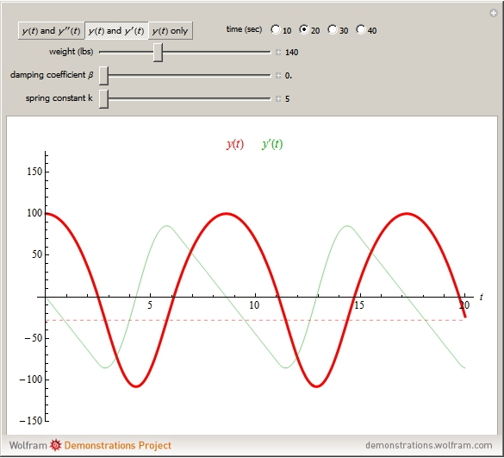

Slide 5
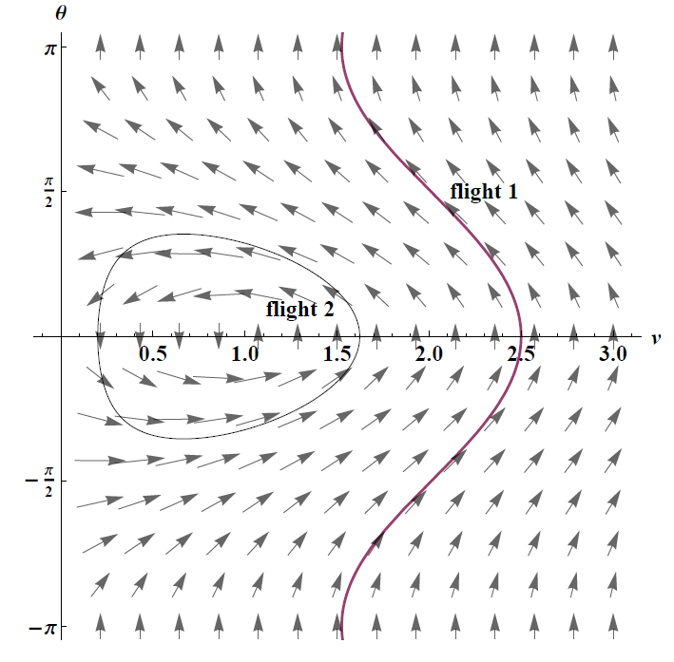

Slide 6
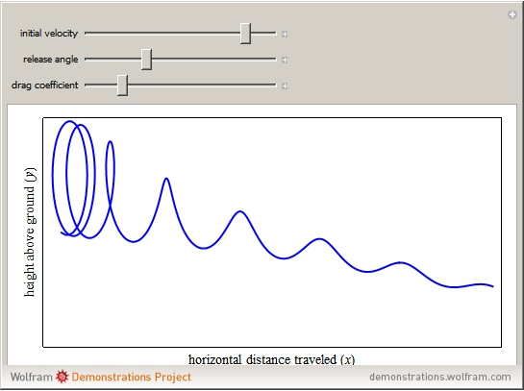

Slide 7
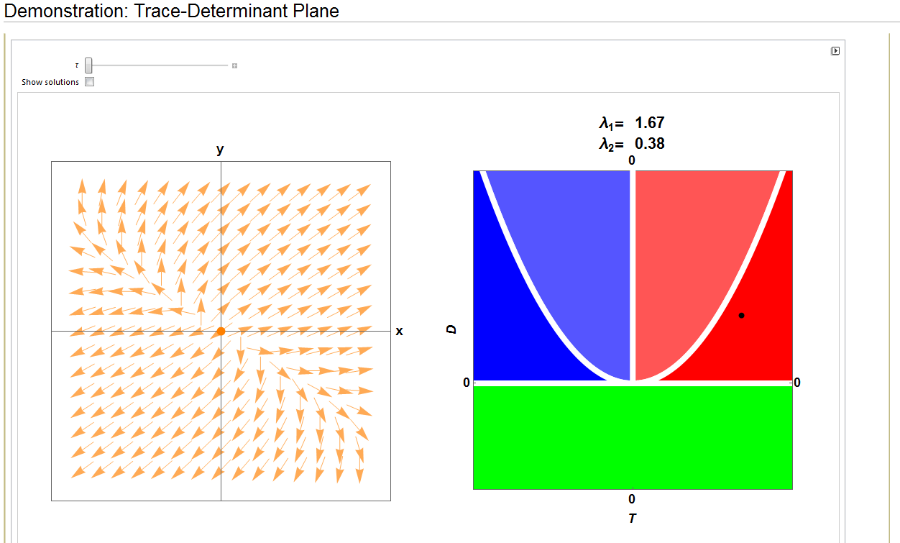

Slide 8
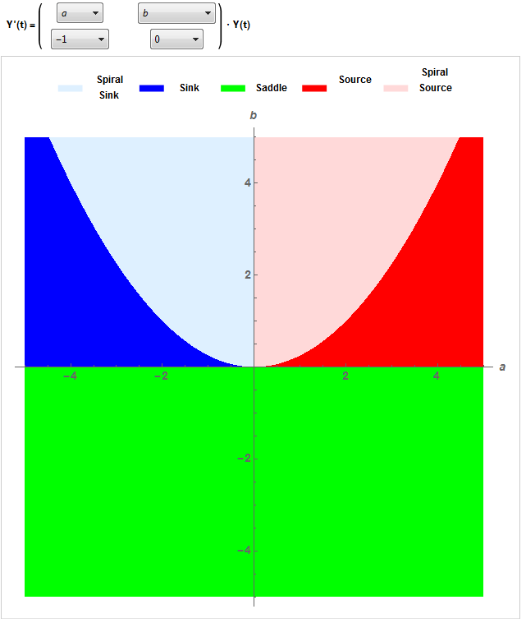

Slide 9
