Slide 1

Inquiry-Based Learning in Mathematics
Helmut Knaust
The University of Texas at El Paso hknaust@utep.edu
NMMATYC/MAA-SW Annual Conference April 15, 2023

Slide 2
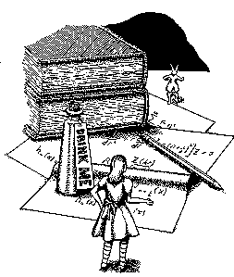
The pillars of IBL teaching
Students deeply engaged in rich
mathematical sense making.
Regular opportunities for students to
collaborate with peers and instructors.
Instructor inquiry into student thinking.
Instructor focus on equity.

Slide 3
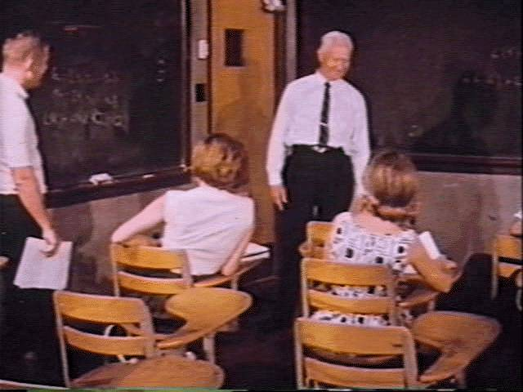
IBL’s History
Historical precursor known as the Moore Method
  or the Texas Method
R.L. Moore (1882-1974)
“That student is taught the best who is told the least.”

Slide 4
Some Courses I have used IBL in:
Wrote a theorem sequence:
  Introduction to Analysis (UG, math majors)
  Numbers (GR, MATM students)
Used theorem sequences from colleagues:
  Logic and Proof (UG, math majors)
  Number Theory (GR, MATM students)

Slide 5
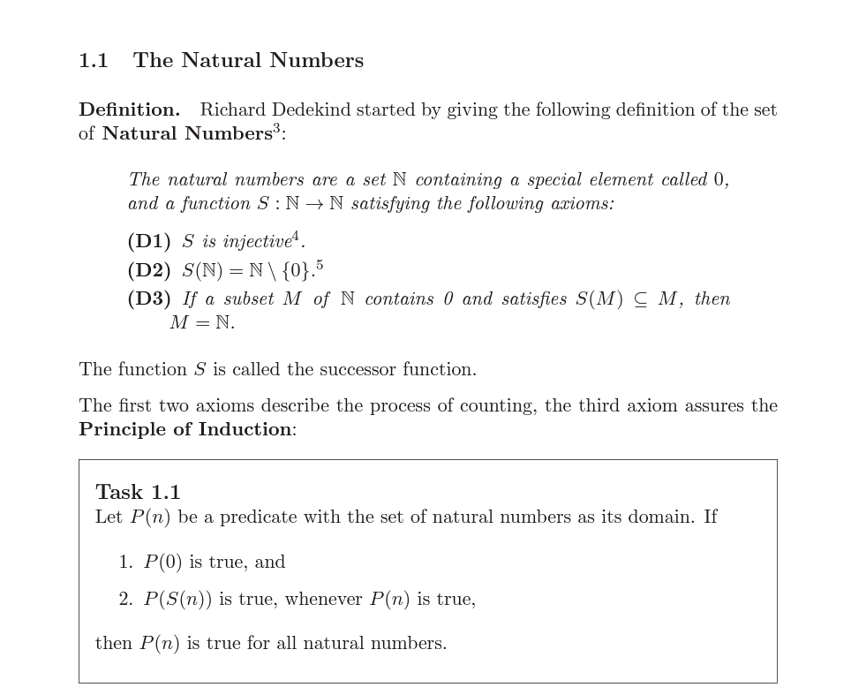

Slide 6
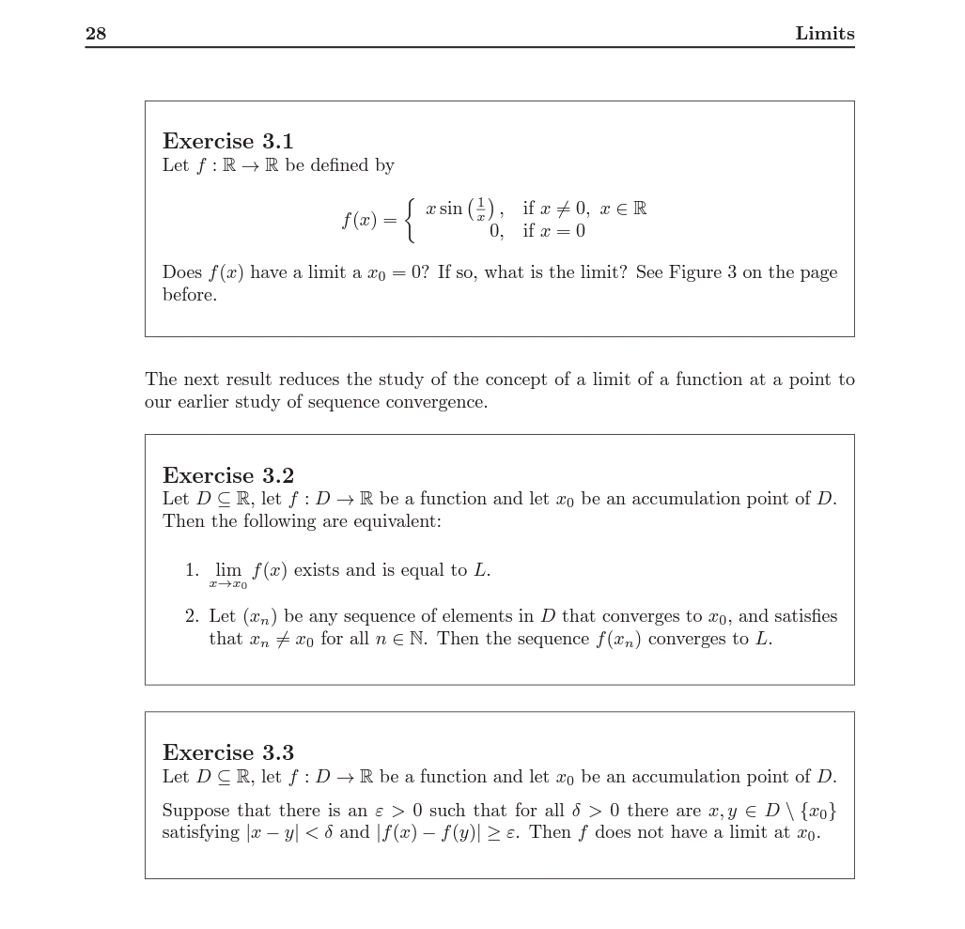

Slide 7
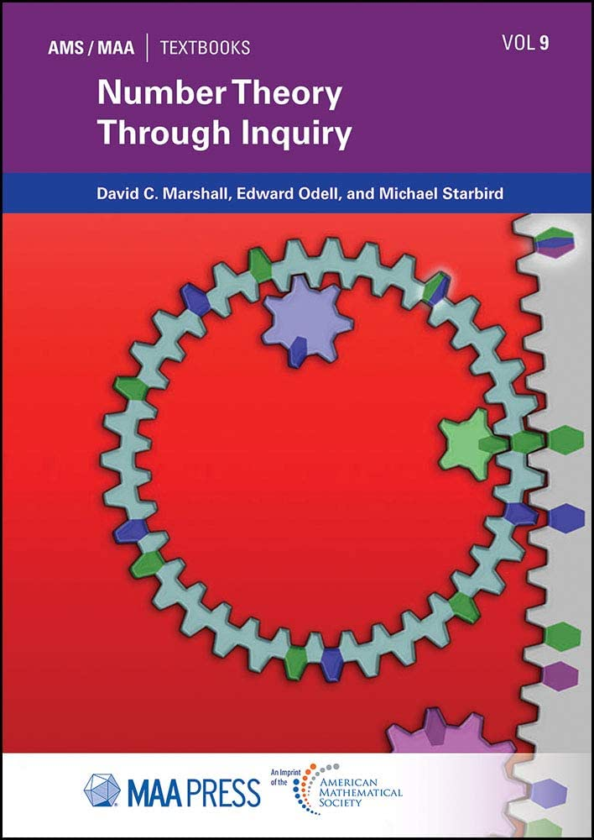

Slide 8
The pillars of IBL teaching, again:
Students deeply engaged in rich
mathematical sense making.
Regular opportunities for students to
collaborate with peers and instructors.
Instructor inquiry into student thinking.
Instructor focus on equity.

Slide 9
A Course for Freshmen/Sophomores
"Introduction to Higher Mathematics“
  Only co-requisite: Calculus I
  Students work in pairs on six “laboratories” on a variety of mathematical topics (two weeks each)
  Students use Mathematica code

Slide 10
The Idea
About 20 years ago, my colleague Art Duval and I decided to create an “Introduction to the Major” course, similar to introductory courses in science and engineering curricula.
Main ingredients:
Calculus ain’t it: The course should portray what mathematicians actually do.
The students are the mathematicians: The course should be student-centered and not lecture-based.

Slide 11
Secondary Thoughts
Such a course may be a good recruiting ground for mathematics majors.
Community college students sometimes arrive on our campus “behind schedule”: Before completing Calculus I there is no other math course for them to take.
This may be a good course for “writing in the discipline”.
The course may alleviate the shock some of our students experience when they start to take proof-based courses.

Slide 12
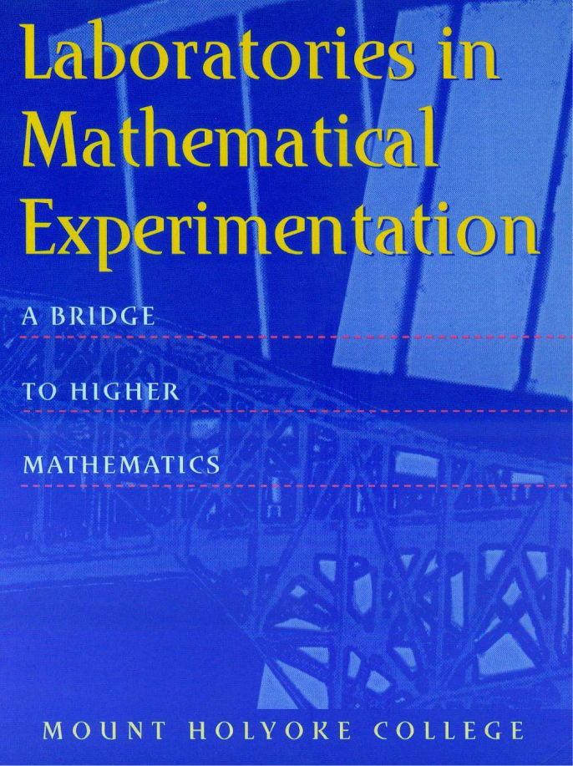
The Textbook
Mount Holyoke College: “Laboratories in Mathematical Experimentation – A Bridge to Higher Mathematics“
Out of print, but available from the speaker (hknaust@utep.edu)

Slide 13
The Laboratories
devise experiment
refine conjecture
conduct experiment
test conjecture
formulate conjecture

Slide 14
The Two-week Laboratories (cont’d)
Short exposition by instructor, maybe 15 minutes
Each lab progresses from pretty straightforward investigations to intriguing open-ended problems
Ultimate goal: Students come up with mathematical conjectures and try to prove them
Students write a substantial laboratory report
  10-15 pages
  Students can resubmit for a new grade once per lab
Instructor provides guidance and feedback all along

Slide 15
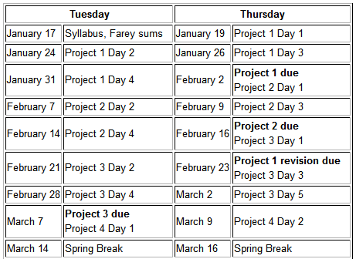
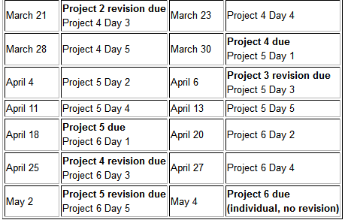

Slide 16
Sample Laboratory: 1. Iteration of Linear Functions
x_{n} = a x_{n-1} +b ; initial value x_{o}
Convergence never
Convergence only if x₀=b/(1-a)
What happens to this sequence as n gets large?
How does the answer depend on a, b and x_{o}?
Convergence always
Convergence only if b=0

Slide 17
The Laboratories (the textbook offers 16 choices)
Iteration of Linear Functions
The Euclidean Algorithm
Parametric Curve Representation
Sequences and Series
Iteration of Quadratic Functions
The p-adic Numbers

Slide 18
Sample Laboratory: 2. The Euclidean Algorithm
Exposition: Explanation how the EA works.
Students read about why the EA works.
Key Questions for Student Investigations:
  How fast does the EA work? Any clue what to expect?
  How often are two “random integers” relatively prime?
  How does the EA work with pairs of integers from the Fibonacci sequence?

Slide 19
Sample Laboratory: 3. Parametric Curve Representation
Study of parametric curves of the form
x(t)= sin(p t) + cos(q t)
y(t)= sin(r t) + cos (s t),
where p,q,r,s are positive integers
Key Question: What parameter choices lead to what symmetries of the parametric curve?

Slide 20
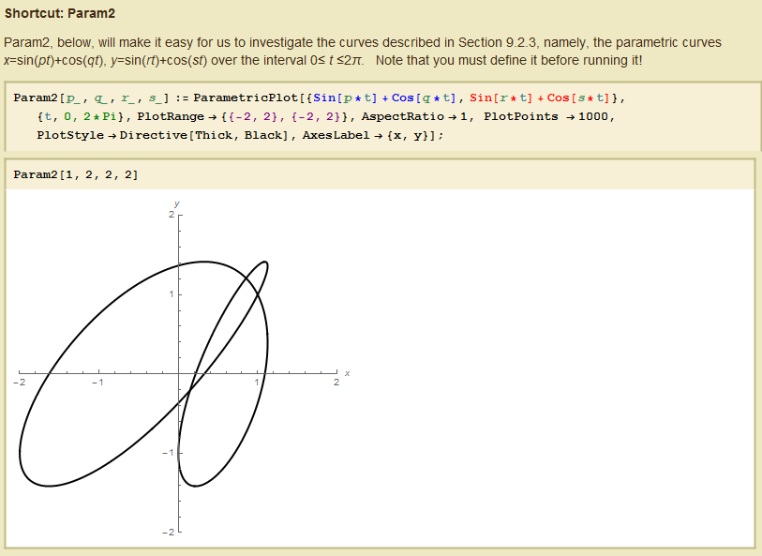
For their investigations, students use Mathematica notebooks
that my colleague Art Duval and I wrote.

Slide 21
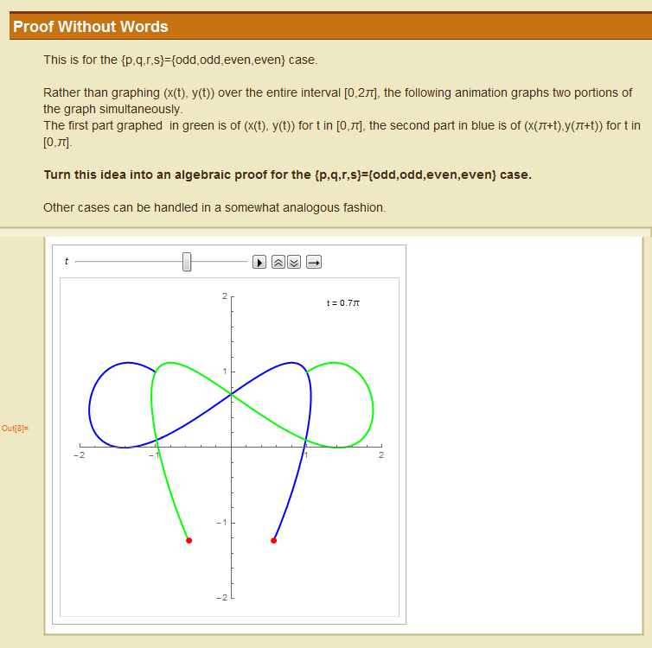
A hint I often give along the way:

Slide 22
Spring 2017: 18 students = 9 pairs
Fall 2021: 26 students = 9 teams (online)
Fall 2022: 12 students = 6 pairs
What students like:
  Everybody has an “Eureka” moment a few times during the semester.
  They can work at their own pace.
What students do not like:
  Lots of writing (each student group writes 100 pages or more during the semester)

Slide 23
What I like:
  Seeing students make progress during the semester: they get noticeably better at exploring and conjecturing
  Seeing students get better at writing in mathematics.
  Once in a while students ask me a question, and I have to explore and conjecture…
What I do not like:
  Lots of reading to grade papers, e.g.:
    6 projects
    9 student pairs
    2 submissions per project
  = about 1,100 pages

Slide 24
The pillars of IBL teaching, again
Students deeply engaged in rich
mathematical sense making.
Regular opportunities for students to
collaborate with peers and instructors.
Instructor inquiry into student thinking.
Instructor focus on equity.
From: The Academy of Inquiry Based Learning (http://www.inquirybasedlearning.org/)

Slide 25

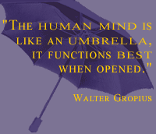
Resources
Academy of Inquiry Based Learning
http://www.inquirybasedlearning.org/
The Journal of Inquiry-Based Learning in Mathematics
http://www.jiblm.org/
Inquiry-Based Learning SIGMAA
http://sigmaa.maa.org/ibl/
The Educational Advancement Foundation
https://www.eduadvance.org/
The author: Helmut Knaust
hknaust@utep.edu
http://helmut.knaust.info/

