Slide 1
Undergraduate Research Experiences at Community Colleges: Models for Engagement, Innovation, and Reward
Benjamin Flores and Helmut Knaust
The University of Texas at El Paso
2024 NMMATYC Conference
El Paso Community College
April 6, 2024
NMMATYC

Slide 2
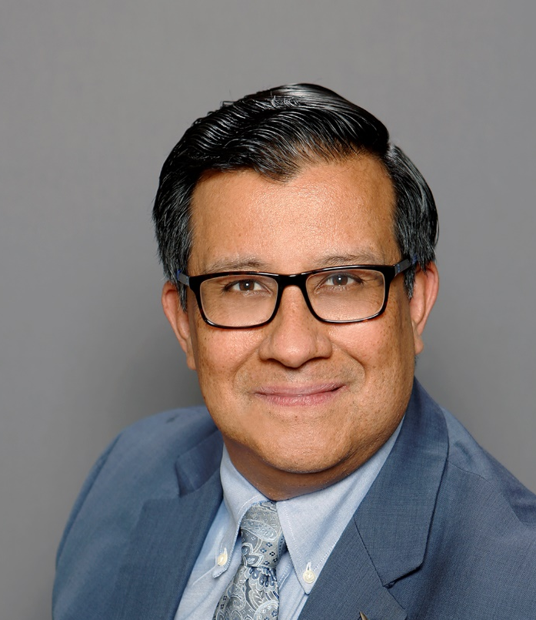
Introductions
Helmut Knaust
Benjamin Flores

Slide 3
Motivation
Undergraduate research is a high-impact practice with the potential to engage student participants in unscripted and creative problem-solving activities under the guidance of motivated faculty.
Students who have participated in undergraduate research report gains in understanding, affinity to their discipline, and professional skills.
Likewise, faculty who serve as mentors of undergraduate researchers report an increase in satisfaction making a difference in their student's success and a renewed sense of commitment in their careers.

Slide 4
Introduction
We will discuss:
how undergraduate research is implemented at community colleges in a way that is consistent with the institutional missions that underscore affordable, quality education for all students and emphasize teaching and service roles for faculty.
ways to sustain and scale up undergraduate research from the perspectives of faculty, curricular programs, and institutions.
resources available to faculty who are interested in becoming better mentors of undergraduate researchers.

Slide 5
UG Research at Two-Year Institutions
Alignment with Institutional mission
Faculty responsibilities
Research infrastructure

Slide 6
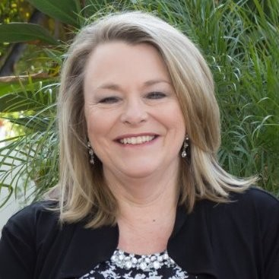
UG Research at Two-Year Institutions
“Don’t let the word research turn you off from considering doing research with students. Opportunities exist all around for students to ask and answer interesting questions even if that opportunity is embedded in courses (course-based undergraduate research experience - CURE) like quantitative reasoning or introductory statistics. And, as you consider potential changes in your curriculum or pedagogy consider that Undergraduate Research Experiences (UREs) are an effective instructional and mentoring practice with the added benefit of increasing persistence and improving graduation rates.”
Laura Watkins
AMATYC Immediate Past President
Glendale Community College

Slide 7
UG Research at Two-Year Institutions
Mentor
Protégé
Protégé
Protégé
Protégé
Mentor
Mentor
Mentor-protégé dyads, triads, groups
Summer programs
Bridge to the Baccalaureate programs
Course-Based Undergraduate Research Experiences (CURES)
Protégé
Mentor

Slide 8
Sustainability and Scale Up
Sustain
Scale Up
Institutionalize
Institutional perspective
Enhancing the mission: access and excellence
Increasing enrollment
Maintaining ties with four-year institutions
Tying UR to development and philanthropy
Academic programs
Enhancing the education experience
Increasing the number of student participants
Faculty perspective
Receiving recognition
Securing funding for students
Committing to data collection, assessment, and improvement

Slide 9
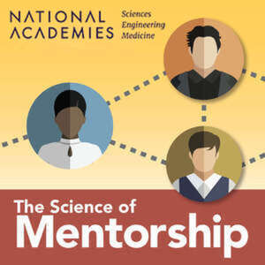
Mentoring
National Academies Definition (The Science of Mentoring)
Mentorship is a professional, working alliance in which individuals work together over time to support the personal and professional growth, development, and success of the relational partners through the provision of career and psychosocial support.
https://nap.nationalacademies.org/resource/25568/interactive/mentorship-defined.html#section1

Slide 10
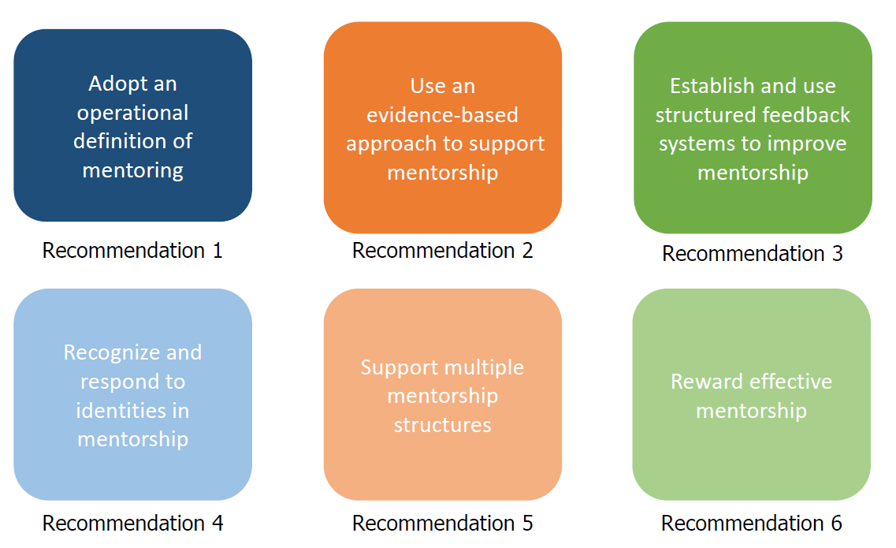
Mentoring National Academies Recommendations

Slide 11
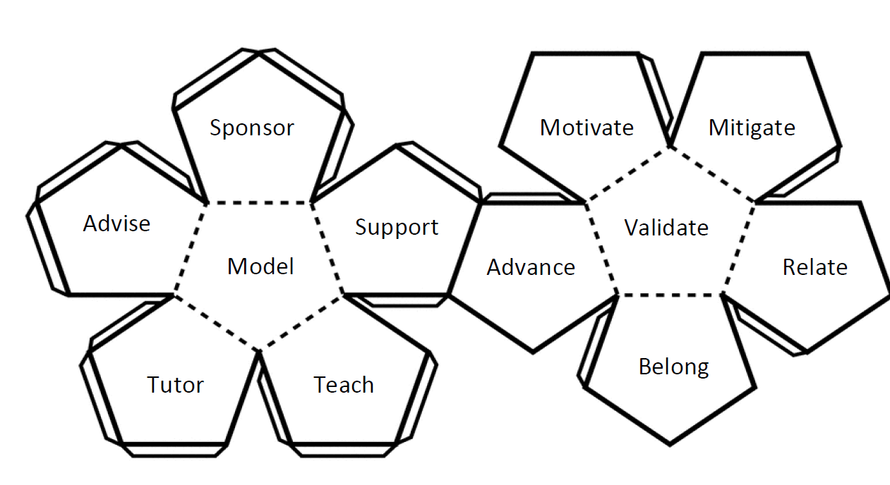
Facets of Mentoring

Slide 12
Facets of Mentoring
Advising. Guiding in areas of cross-functional expertise. Examples: selecting courses, reviewing short-term and long-term educational planning, and discussing time management.
Advocating. Recommending or supporting the protégé. Examples: writing letters in support of graduate school applications, serving as a reference for scholarship applications, and nominating the protégé for special recognition.
Facilitating. Assisting to make processes easy to bring about an outcome. Examples: Guiding conversations in the classroom or laboratory, referring the protégé to a campus resource or office.
Mitigating. Lessening the adverse effects of circumstances, undue burden, or mistakes. Examples: sharing tactics to deal with micro-aggressions, giving words of encouragement, and providing perspective to insensitive feedback.
Serving as a Model of Identity. Exhibiting positive personal and professional traits or qualities in activities that are characteristic of the profession (Nadelson et al., 2017). Examples: Giving credit where credit is due, balancing confidence and humility, and showing empathy toward others.

Slide 13
Facets of Mentoring
Motivating. Promoting curiosity, enthusiasm, and passion for goal attainment. Example: Showing excitement for research, encouraging the completion of a task, cheering on behaviors and accomplishments,
Sponsoring. Serving as a benefactor by providing financial support, educational materials or supplies, and career-advancing opportunities (Ayyala et al., 2019). Examples: Providing a stipend to compensate the protégé for participation in research, promoting the protégé at a networking event, and protecting the protégé from negative influences.
Tutoring. Providing one-on-one or small-group teaching with a specific objective in mind. Examples: Training on the use of instrumentation, discussing habits of effective learning.
Validating. Acknowledging protégés as valuable members of a learning community, capable of creating knowledge and being successful (Rendon, 1994). Examples: Affirming the value of diversity in higher education, acknowledging contributions, and celebrating accomplishments, successes, and honors.

Slide 14
Mentoring Philosophy
Operational Definition
Motivations
Approach
Virtuous Assessment Cycle
Dissemination

Slide 15
Mentoring Stages
Matching
Rapport Building
Goal Setting
Closure and Moving On
Progression
Mentoring Process

Slide 16
Mentoring Stages
Matching. In this initial phase, the protégé is assigned to a mentor based mostly on academic discipline and research interests. Mentors and protégés are introduced to each other, often in a social event that welcomes participants and reminds everyone of programmatic goals.
Rapport Building. Next, the mentor and protégé are allowed to develop a rapport that leads to mutual respect building, a general agreement on the purpose of the relationship, and expectations on both ends of the relationship.
Goal Setting. In this phase, the mentor sets immediate and end-of-project research goals. The protégé should have an opportunity to discuss program expectations (such as professional development activities, poster development, and conference participation) and the type of support they can expect from the protégé.

Slide 17
Mentoring Stages
Progression. This phase is characterized by the most intense learning time interval for both the mentor and the protégé. An effective mentor will assist the protégé in focusing on reaching project milestones while responding to the protégé’s needs. Specifically, this phase is a space for implementing inclusive mentoring practices such as establishing a safe environment, building confidence through validation, inviting people to raise and address issues from both perspectives and stimulating personal and professional growth and autonomy.
Bringing Closure and Moving On. This is essentially the winding-down stage in which the protégé shares accomplishments and the mentor participates in celebrating what they have achieved. At this point, the mentor assists the protégé in reformulating their relationship collegially. In some instances, this may lead to a renewal of commitments where the protégé is encouraged to consider graduate studies upon completing their college degree.

Slide 18
Case Studies
After an eventful career in the US Army, Colin enrolled at the local community college… His biology professor took an interest in Colin and invited him to participate in a bridge to the baccalaureate… Colin earned his Associate’s degree, transferred to a nearby university, and joined a research lab… he earned his BS and began his Ph.D. studies… He conducted research under the mentorship of a renowned researcher. After defending his dissertation, Colin moved to DC where he now works at the NIH. Ten years had gone by since he enrolled at the community college.
Highlighting
Student population
Institutional profile

Slide 19
Closing Remarks
Best practices for mentoring are evidence-based (scientific)
The needs and assets of community college protégés are distinct
Commuter students
Diverse backgrounds
CC mentors should be aware of these needs and assets
Mentors should be aware of the multiple roles they may play over time
Developing a mentoring philosophy is a desirable goal
Mentor and protégé should share their expectations early on in the relationship
Mentors should assess their work for impact and reflect on their experiences
Institutions should encourage, recognize, and reward mentorship excellence
The impact of poor mentorship should be minimized at all cost

Slide 20
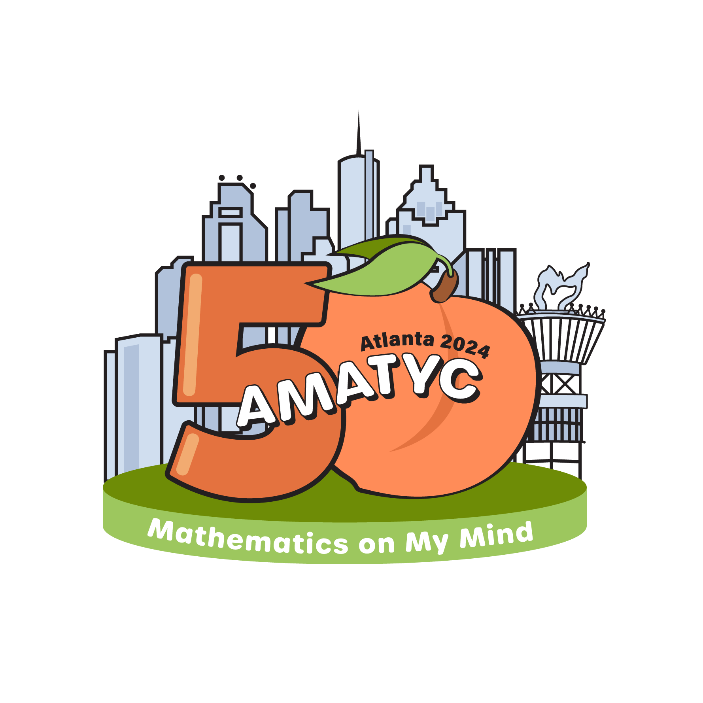
See You in Atlanta!
Helmut Knaust hknaust@utep.edu
Ben Flores bflores@utep.edu

Slide 21
Acknowledgment and Disclaimer
Funding for this work was provided by the National Science Foundation under grants 2020697 and 1826745.
Any opinions, findings, conclusions, or recommendations expressed in this material are those of the authors and do not necessarily reflect the views of the National Science Foundation.

