Slide 1
Two Support and Professional Development Programs for STEM Future Faculty:
Lessons Learned
Benjamin C. Flores, Ph.D.
2024 H-AGEP Conference
El Paso, TX
May 16, 2024

Slide 2
Pathways to the Professoriate
Pathways are as diverse as the people that take them.
Bachelor’s
Master’s
Workforce
Professoriate
Ph.D.
Ph.D.
Ph.D.
Professoriate
Postdoc
Professoriate
Master’s
Professoriate
Professoriate
Professoriate

Slide 3


Two Support and Professional Development Programs
NSF Louis Stokes Alliance for Minority Participation – Bridge to the Doctorate
NSF INCLUDES Aspire Alliance – West Texas Regional Collaborative
At the core of these two programs is the practice of holistic mentoring.

Slide 4
Operational Definition of Mentoring
Holistic mentoring is a multifaceted, reciprocal, and conscious relationship in which a mentor engages a protégé or group of protégés from diverse backgrounds to advance their goals and to learn from their professional development experiences.
In addition to guiding the discovery of intellectual passions, providing advice and access to resources, and advocating for their protégés, holistic mentors readily acknowledge their protégés identity, validate their backgrounds and accomplishments, and provide supportive environments to prevent isolation by promoting cultural awareness and sensitivity.
Mentors and protégés work together toward a better future by engaging each other in a virtuous cycle of learning and holistic growth of the individual.

Slide 5
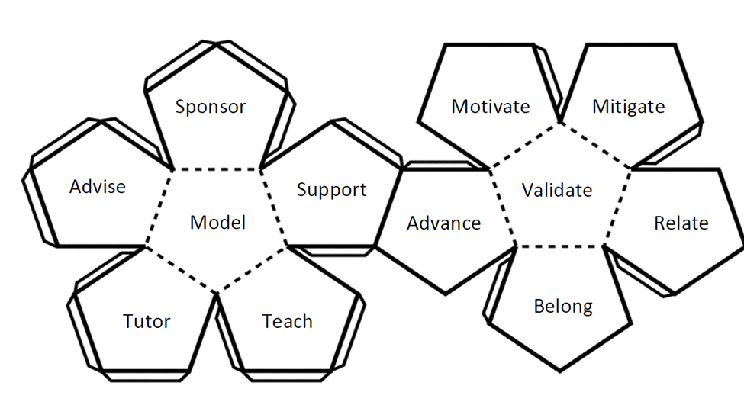
Facets of Mentoring
7
8
1
12
11
9
5
2
6
10
4
3

Slide 6
Mentoring Cycle Timeline
Matching (Selection)
Expectations Setting (Alignment)
Closure
Relationship Cultivation

Slide 7
LSAMP Bridge to the Doctorate (BD)
Funded by the National Science Foundation
Operating since 2003
Supports multidisciplinary graduate student cohorts
Provides competitive two-year fellowships
Includes a professional development component (BD seminar)
LSAMP institutions: UTEP (7), UTA (2), UTD (1), UTRGV (1), UTSA (1)
Most recent BD cohort (12 Ph.D. students) at UTEP

Slide 8
UTEP BD Fellows
Year | Number of Participants | Earned Master’s | Earned PhD
2005 | 12 | 3 | 9
2008 | 12 | 2 | 7
2009 | 12 | 4 | 8
2011 | 12 | 5 | 6
2013 | 12 | 4 | 7
2018* | 12 | 0 | 6
2022 | 12 | NA | NA
Total | 84 | 18 | 43
*6 students are enrolled and pursuing their Ph.D.'s
43/72 or 60%

Slide 9

BD Seminar
4 semesters
1 hour per week
Professional Development Curriculum
  One-minute elevator speech
  Research abstract
  Research presentations (updates)
  On-campus laboratory tours
  Teaching Philosophy Statement
  Research statement and plan
  Publish and flourish workshop
  Mental Health workshop
  Intersectionality workshop
  Other
Service Component
  UT System LSAMP Conference panel
  UT System LSAMP Conference research poster judging

Slide 10
The Versatility of the Ph.D.
Academia
UTEP
UT Austin
Government
National Sandia Labs
NIH
Industry
Business
UT Permian Basin
El Paso Community College
Federal Aviation Administration
Defense Threat Reduction Agency
Other
Entrepreneurship
Ph.D.

Slide 11
BD Fellows: Where are they now?
Name | Degree | Cohort | Position
Brandon Aguirre | Ph.D. ECE | 2008 | Sandia National Labs
Miroslava Barua | Ph.D. ECE | 2003 | Assistant Professor of Instruction, UTEP
Aryzbe Diaz | Ph.D. ECE | 2007 | Assistant Professor of Instruction, UTEP
David Espalin | Ph.D. Mechanical Engineering | 2011 | Associate Professor of Mechanical Engineering, UTEP
Angelica Lopez | Ph.D. Biological Sciences | 2011 | Science Manager, DTRA
Arlene Smith | Ph.D. MASE | 2018 | Scientist, Air Force Research Laboratory
Shalayna Smith (nee. Lair) | Ph.D. MASE | 2005 | Associate Professor of Instruction, Metallurgical and Materials Engineering, UTEP
Milka Montes | Ph.D. Chemistry | 2005 | Chair, Associate Professor, Chemistry, UTPB
David Roberson | Ph.D. MASE | 2009 | Associate Professor, Metallurgical and Materials Engineering, UTEP
Pedro Santacruz | Ph.D Electrical Engineering | 2005 | Associate Professor of Instruction, Electrical and Computer Engineering, UT
Christian Servin | Ph.D. Computer Science | 2005 | Associate Professor, EPCC
Colin Knight | Ph.D. Biological Sciences | 2018 | National Institutes of Health
Jessica Shenberger | Ph.D. Psychology | 2008 | Associate Dean, School of Pharmacy, UTEP
Berenice Verdin | Ph.D. ECE | 2005 | US Army Dev Comm

Slide 12
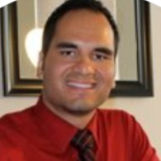
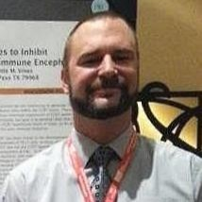
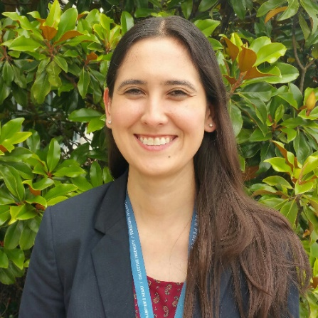
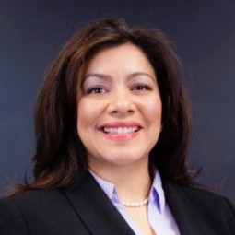
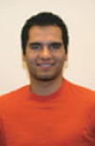
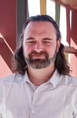
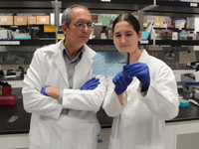
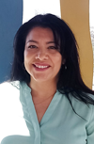
Success Stories
Dr. Marcos Bolanos, ECE
FAA,
Dr. Colin Knight, Biology
NIH,
Dr. Angelica Lopez, Biology
DTRA
Dr. Arlene Smith, MASE
AFRL

Slide 13
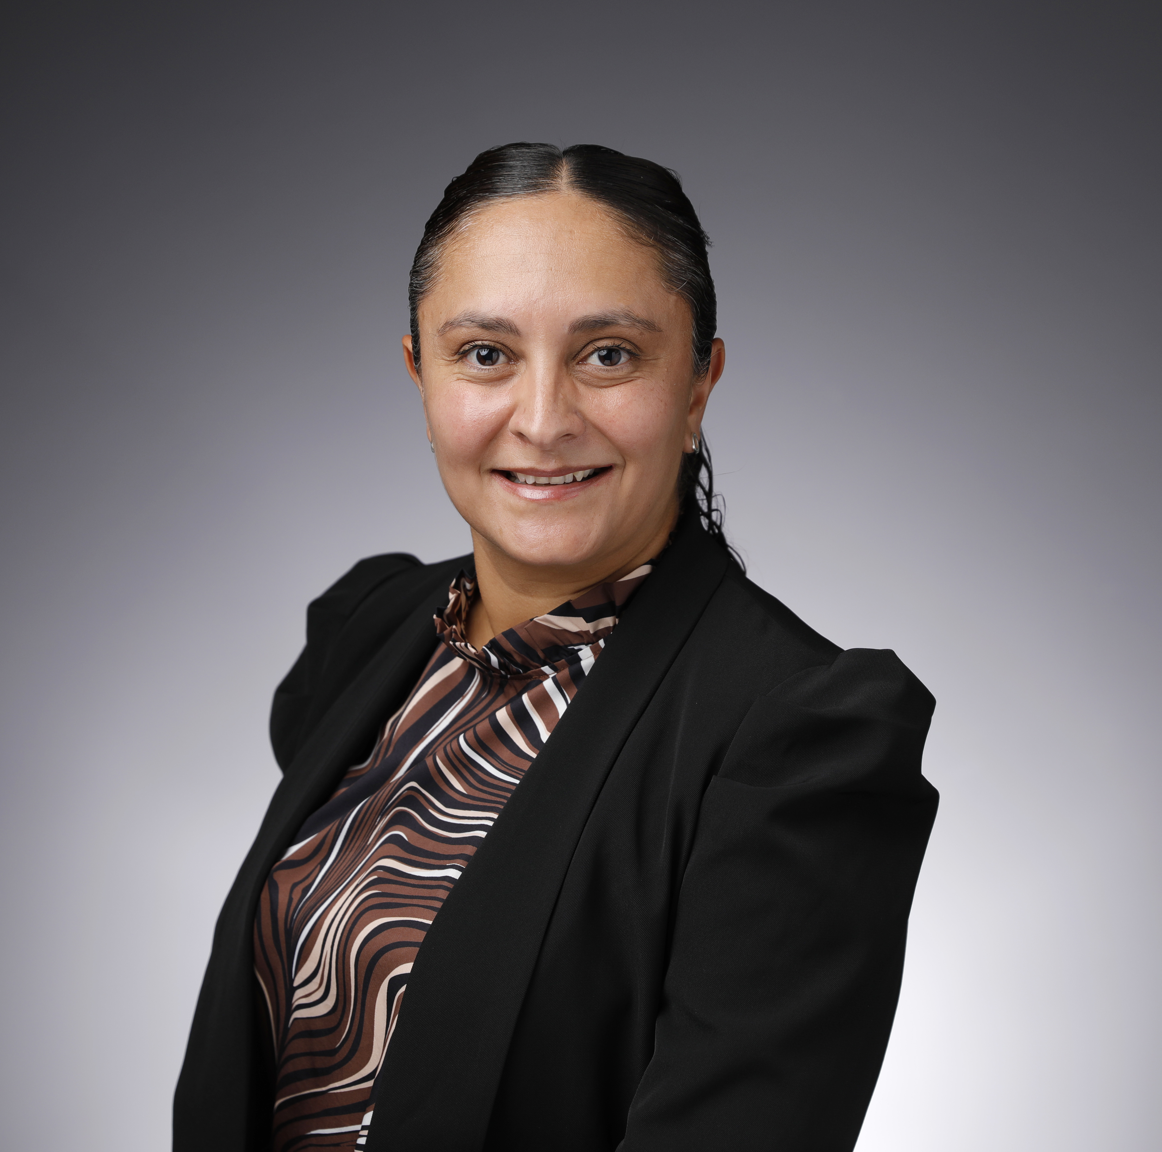
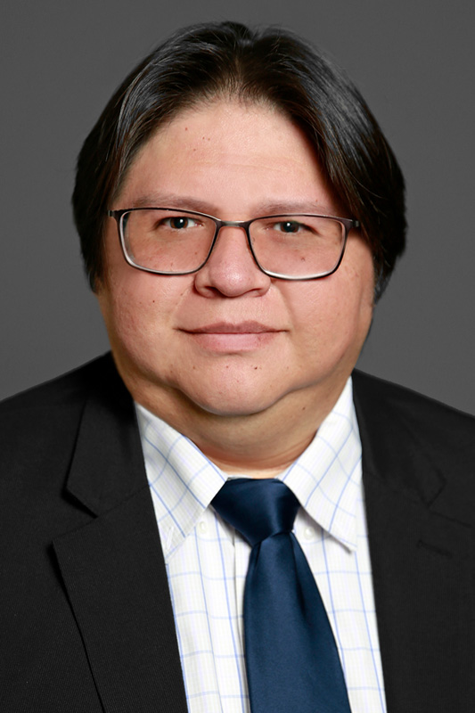
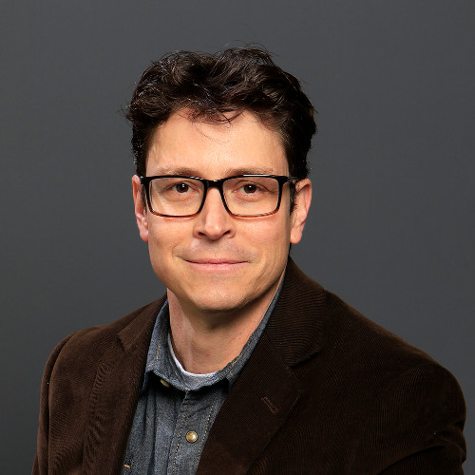
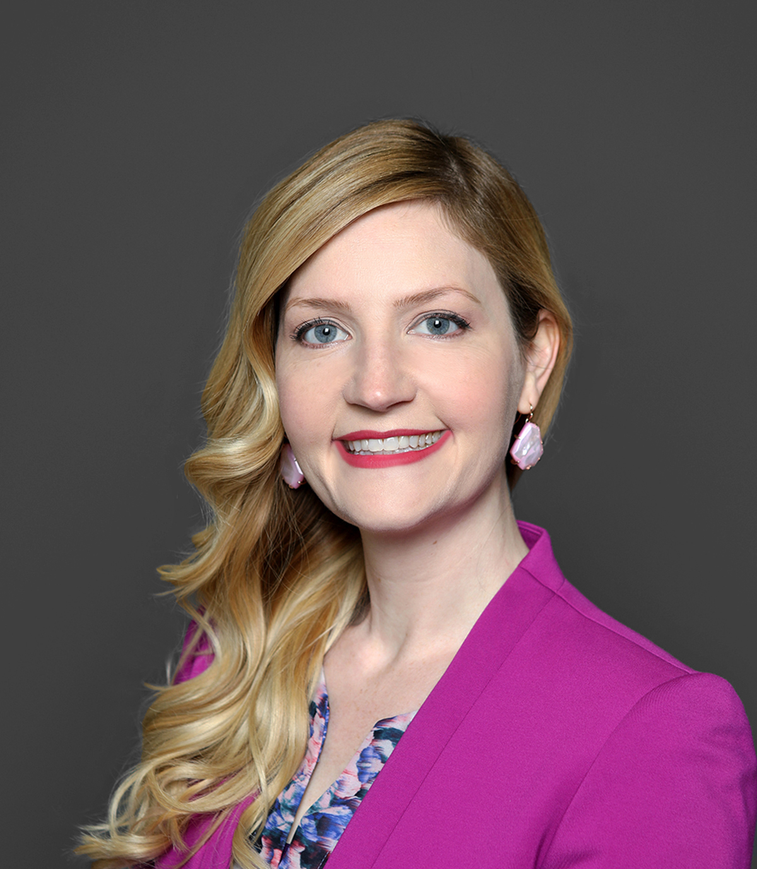
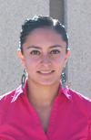
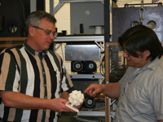
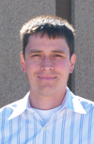
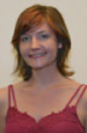
Success Stories
Dr. Aryzbe Najera
UTEP ECE Dept.
Dr. David Espalin
UTEP AME Dept.
Dr. David Roberson
UTEP MMBE Dept.
Dr. Shalayna Smith
UTEP MMBE Dept.

Slide 14
BD Mentoring Model
Financial Support
Coursework
Mentorship-Protégé Relationship
Research Mentoring
Professional Development Coaching
Protégé
TIME

Slide 15
Assessment Summary
2019 – 2021 Cohort
During COVID-19 assess students':
  Perceptions of mentoring
  Perceptions of support
  Resiliency factors
  Resources used
  Impact on academic/professional goals
  Difficulties working/learning remotely

Slide 16
Resiliency
Personal Competence (M = 4.01)
  "I believe in my own abilities."
  "No matter what happens I always find a solution."
Help Seeking/Adaptation (M = 4.07)
  "If I needed help, I would feel comfortable asking for assistance (e.g., from your thesis or dissertation chair, mentor, or others)."
Strongly Disagree | Disagree | Neither Disagree nor Agree | Agree | Strongly Agree
1 | 2 | 3 | 4 | 5

Slide 17
Personal Competence
Item | Mean
I believe in my own abilities. | 3.73
Believing in myself helps me to overcome difficult times. | 4.18
I know that I succeed if I carry on. | 4.36
I know how to reach my goals | 3.73
No matter what happens I always find a solution. | 4.09
I am comfortable with other persons. | 3.91
My future feels promising. | 4.00
I know that I can solve my personal problems. | 4.00
I am pleased with myself | 3.36
I have realistic plans for the future. | 4.27
I completely trust my judgements and decisions. | 4.00
At hard times I know that better times will come. | 4.55

Slide 18
Help Seeking/Adaptation
Item | Mean
If I needed help, I would feel comfortable asking for assistance (e.g., from your thesis or dissertation chair, mentor, or others). | 4.09
If I ran into a technology issue while completing educational or research activities, I know where to go for help. | 4.27
I know where to seek help from my department, lab, or program as needed | 4.18
I know where to seek academic resources at UTEP if needed. | 4.18
I know where to seek research resources at UTEP if needed. | 4.27
I know where to seek health care resources at UTEP if needed. | 3.73
I know where to seek mental health resources at UTEP if needed. | 4.00
I know where to seek financial resources at UTEP if needed. | 3.82

Slide 19
Support Structures
Academic (M = 4.07)
  "My thesis/dissertation chair or mentor provides me the support that I currently need."
Personal (M = 4.49)
  "I have access to safe, secure housing."
Strongly Disagree | Disagree | Neither Disagree nor Agree | Agree | Strongly Agree
1 | 2 | 3 | 4 | 5

Slide 20
Academic Structure
Item | Mean
My course instructors have been supportive through the challenges of the pandemic. | 4.36
My thesis/dissertation chair has been supportive through the challenges of the pandemic. | 4.09
UTEP support services have provided me with the help I need at this time. | 3.97
My department, program, or lab has been supportive through the challenges of the pandemic. | 4.00
My thesis/dissertation chair or mentor provides me the support that I currently need. | 3.91

Slide 21
Personal Structure
Item | Mean
I have access to safe, secure housing. | 4.64
I have access to health care as needed. | 4.64
I have sufficient access to food and personal care items. | 4.64
I have the needed social supports (e.g., family, friends, peers) to get through the COVID-19 situation. | 4.36
I have the resources (e.g., information and tools) that I need to be productive. | 4.18

Slide 22
Academic/Professional Concerns
Item | Mean
My course instructors have been supportive through the challenges of the pandemic. | 4.36
My thesis/dissertation chair has been supportive through the challenges of the pandemic. | 4.09
UTEP support services have provided me with the help I need at this time. | 3.97
My department, program, or lab has been supportive through the challenges of the pandemic. | 4.00
My thesis/dissertation chair or mentor provides me the support that I currently need. | 3.91

Slide 23
Confidence in their ability to make timely progress...
 | Pre-COVID | During COVID
Graduate Education | 4.64 | 3.73
Professional Development | 4.64 | 2.73
Thesis / Dissertation | 4.64 | 3.27

Slide 24
Conclusions
Students felt:
  Competent in their abilities
  Supported
  Comfortable asking for help
Students had strong academic and personal structures
Difficulties/concerns during COVID-19:
  Keeping a regular schedule
  Low physical activity
  Anxiety about not going back to "normal" after COVID-19

Slide 25
Impact
Insights into the impacts of COVID-19
Targeted assistance
Leadership provided resources at UTEP
  Mental health
  Financial aid
  Anxiety workbook

Slide 26
NSF INCLUDES Aspire Alliance
Funded by the National Science Foundation
Supported cohorts from 2019 to 2023
Provided Aspire Fellowships to graduate students from all disciplines
Included The University of Texas at El Paso, El Paso Community College, The University of Texas Permian Basin, Midland College, Odessa College (West Texas Regional Collaborative)
Focused on professional development around teaching and exploring careers at two-year colleges

Slide 27
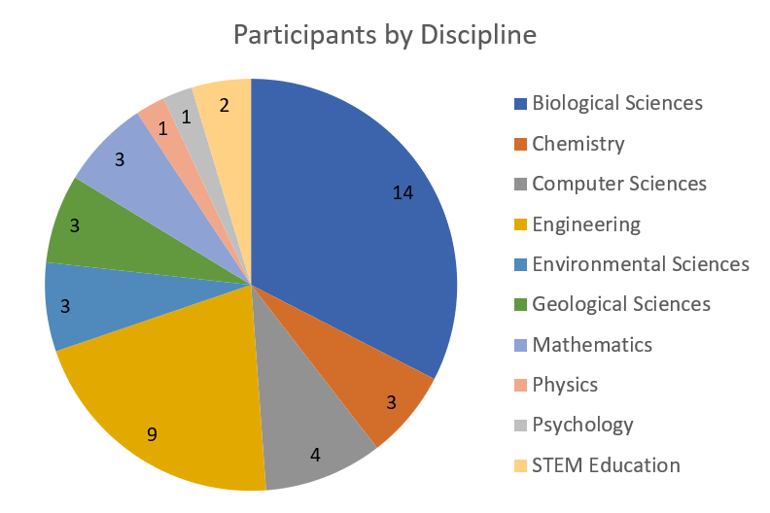
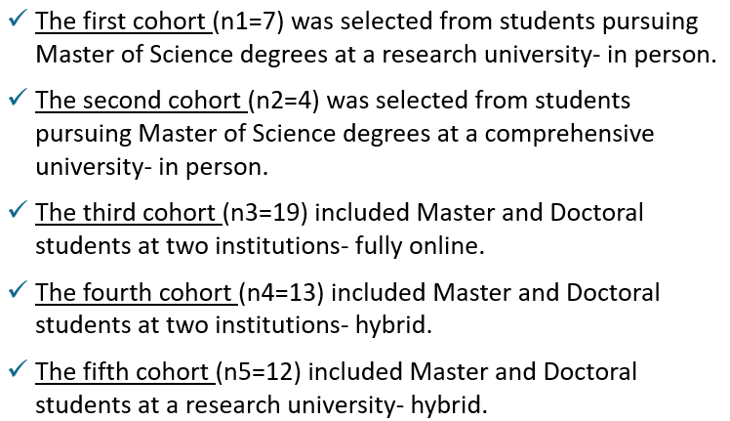
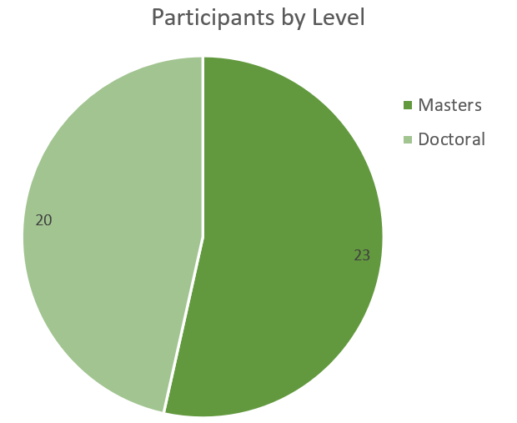
Aspire Fellows
COHORT | NUMBER OF PARTICIPANTS | NUMBER OF DISCIPLINES
2019 | 7 | 7
2020 | 4 | 3
2021 | 19 | 12
2022 | 13 | 6
2023 | 12 | 9

Slide 28

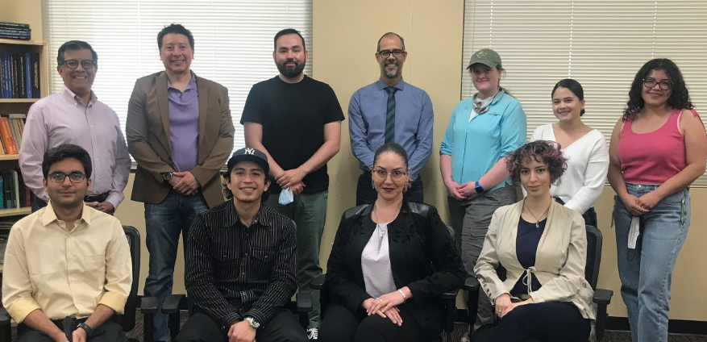
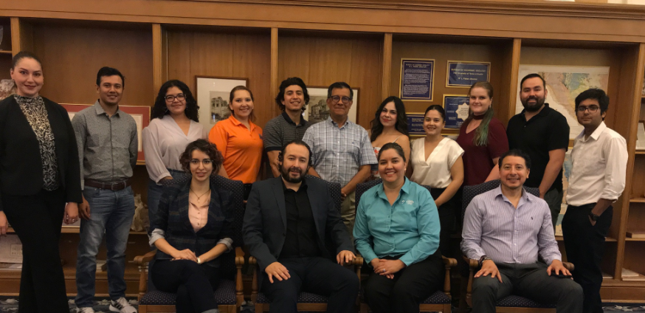
ASPIRE Webinars
Mission of Community Colleges
Active Learning Strategies
Lesson Plans
Teaching Philosophy Statements
Professional Networking through
TYC organizations
Teaching Portfolios
Applying for Jobs at Community
Colleges

Slide 29
Example: The Mission of Community Colleges
From the beginning, the purpose of Community Colleges has been to provide access to higher education for students who otherwise would have been denied the opportunity
Source: A Policy Analysis of Community College Funding in Texas, Don. C. Hudson, 2008.
Curriculum
Service
Teaching

Slide 30
Mentoring Model: Pre and Post Pandemic
Protégé
CC Faculty Mentor
University Mentor
Protégé
CC Faculty
Program Team
CC Administrator

Slide 31
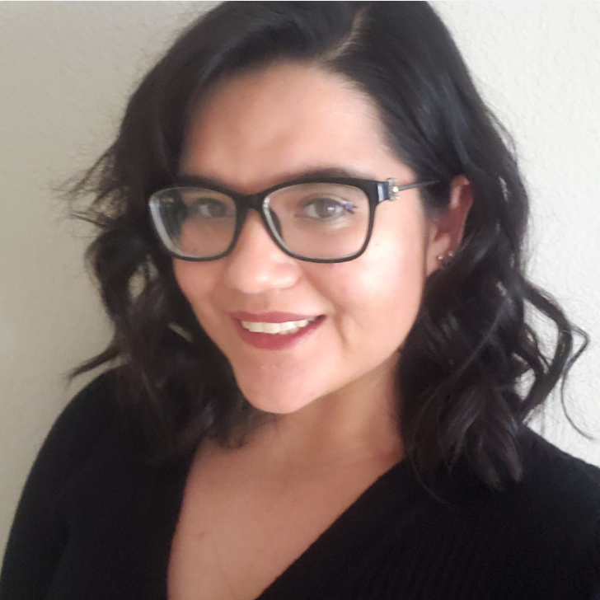
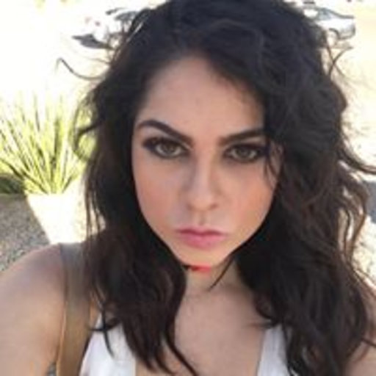
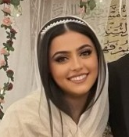
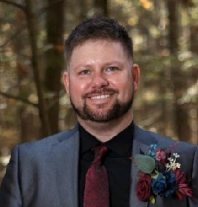
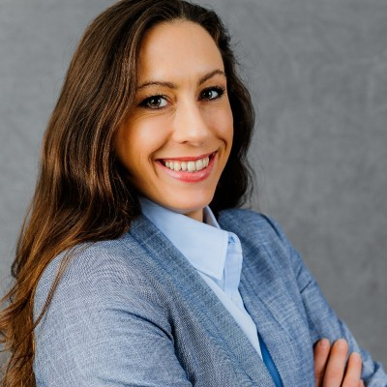
Success Stories
Jocelyne Guzman
Ph.D. Student
UTEP
Diana Olivas
Ph.D. Student
UTEP
Zahraa Issa
Ph.D. Student
UT Dallas
Jay English
Ph.D. Student
U Massachusetts
Alexandra Price
Ph.D. Student
University of Houston

Slide 32
ASPIRE Assessment Summary
On average, proteges are very likely to apply their learnings from the practicum (M = 5.39, on a 6-point scale), while 62% are ‘extremely’ likely to apply these learnings.
A total of 10% of respondent proteges stated they had secured jobs shortly following completion of the practicum, but 26% had yet to begin their job searches, likely due to the amount of time left in their graduate programs.
Proteges’ experienced notable improvements in their knowledge of two-year college faculty careers and the credentials required to teach at community colleges, which indicates the efficacy of the practicum in terms of exposing students to community college teaching as a career.
Skill levels reported by proteges also increased notably, with notable gains in areas around equitable and inclusive teaching. E.g., there was a 24.3% pre-post increase in skill level for creating a classroom environment that cultivates a sense of belonging for diverse students.
Greater confidence levels were reported following completion of the practicum. The greatest area of improvement was in proteges’ confidence to teach in a community college, showing a mean 32.3% increase in confidence scores following completion of the practicum.
Proteges reported that they were more interested in community college teaching than prior to the practicum. Interest in a community college faculty career in STEM also increased notably, by 24%.

Slide 33
Lessons Learned
Mentoring projects with a professional development component enrich the graduate student experience and allow for close monitoring of degree advancement.
Milestone celebrations are an integral component of programming.
Formative assessment provides opportunity for periodic program improvements.
Program staff must be prepared to mitigate negative experiences due to mentor/protégé relationships go awry.
Mental health awareness, coaching, and resources humanize the graduate student experience.
It takes a village: joint efforts coalesce people’s assets that improve the graduate student experience.

Slide 34
Resources
Flores, B. C., Shenberger-Trujillo, J., & Montes, M. (2023). Mentoring Graduate Underrepresented Minorities in STEM. Making Connections.
https://digitalcommons.usu.edu/makingconnections/23/
https://www.utep.edu/engineering/aspire/
https://www.utep.edu/lsamp/

Slide 35

Disclaimer and Acknowledgement
Funding for this work was provided by the National Science Foundation (under grants 2020697, HRD-1826745, and EES-2204750) and the Forrest O. and Henrietta Lewis Professorship of Electrical Engineering.
Any opinions, findings, conclusions, or recommendations expressed in this material are those of the author and do not necessarily reflect the views of the National Science Foundation.

