Slide 1


Bridge to the Doctorate Seminar Series: Coaching the Next Generation of STEM Professionals
Ariana Arciero-Pino, M.P.H.
Helmut Knaust, Ph.D.

Slide 2


What is Bridge to the Doctorate?
Funded by the National Science Foundation (NSF)
Began in 2003 as an initiative to support Louis Stokes Alliance for Minority Participation (LSAMP) alumni during their first two years of graduate studies
Available to national LSAMP alliances in Phase III or later
Two-year project that funds 12 STEM Ph.D. students:
Full tuition and fees
$32,000 / year stipend
Student Health Insurance
Professional development
High-quality mentorship
Institutional funding following 2-year BD tenure

Slide 3
What is Bridge to the Doctorate?, cont.
Program Objectives
Recruit and select a cohort of highly-motivated and well-prepared BD Fellows
Induct BD Fellows into competitive research laboratories and projects
Provide a complete and relevant professional development program
Create a positive social environment with network and peer support
Provide rich, continuous mentoring experiences
Provide financial planning skills and security for the duration of doctoral studies.

Slide 4
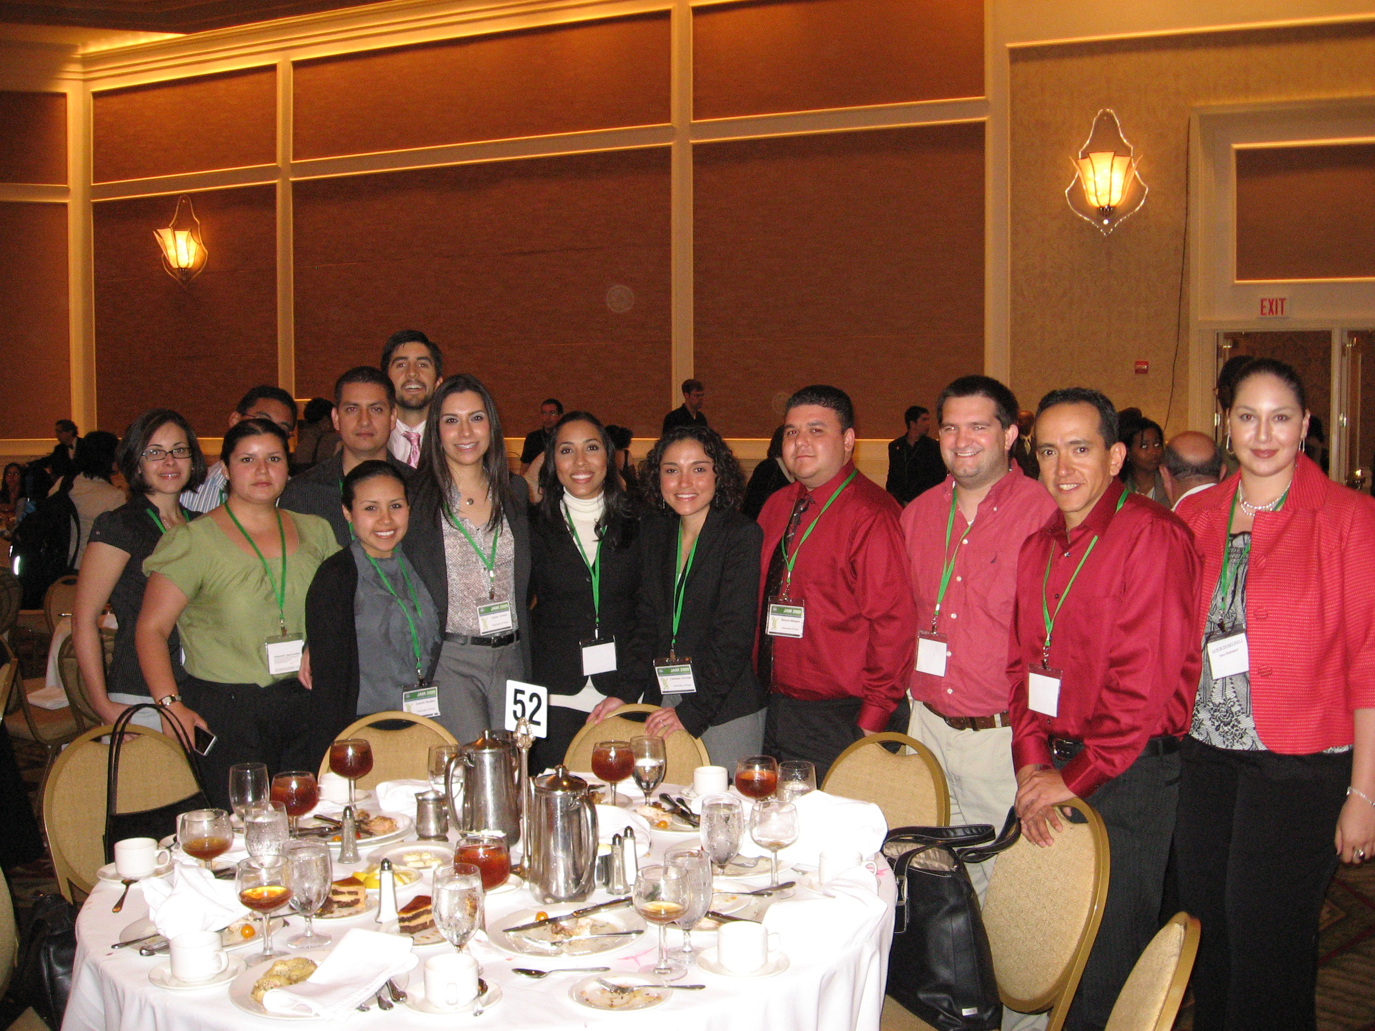
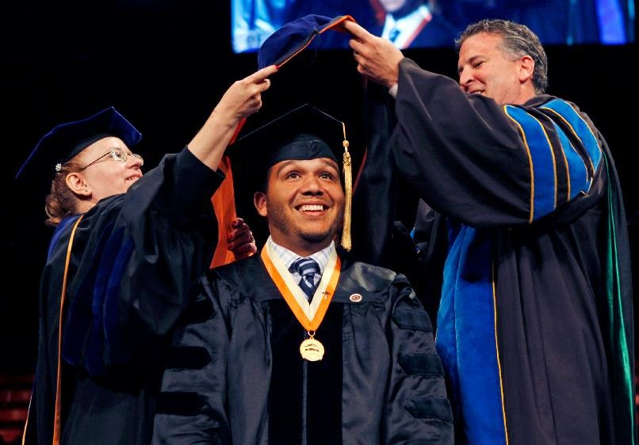
Bridge to the Doctorate in the UT System
Campus | BD Award Years
UT El Paso | 2003, 2005, 2008, 2009, 2011, 2013, 2018
UT Rio Grande Valley | 2004
UT Arlington | 2010, 2014
UT San Antonio | 2012

Slide 5
Bridge to the Doctorate in the UT System cont.
Table 1. UT System LSAMP BD Cohort Information
UT System Campus | NSF Cohort Number | Cohort Years | # of Ph.D.’s awarded
UT El Paso (n=10) | I | 2003 – 2005 | 3
UT Rio Grande Valley, formerly UT Pan American (n=12) | II | 2004 – 2006 | 3
UT El Paso (n=12) | III | 2005 – 2007 | 8
UT El Paso (n=12) | VI | 2008 – 2010 | 7
UT El Paso (n=12) | VII | 2009 – 2011 | 8
UT Arlington (n=12) | VIII | 2010 – 2012 | 10
UT El Paso (n=12) | IX | 2011 – 2013 | 5
UT San Antonio (n=12) | X | 2012 – 2014 | 9
UT El Paso (n=12) | XI | 2013 – 2015 | 2
UT Arlington (n=11) | XII | 2014 – 2016 | 1

Slide 6
A Few Numbers
Underrepresented Minority Student (URMs) Statistics
9% of STEM-related Ph.D. degrees are earned by URMs (NSF, 2013; 2002-2012)
UTEP Statistics
13 STEM Ph.D. disciplines
In fall 2015, over 700 students were enrolled in doctoral programs.
In 2013-2014, 127 students earned the Ph.D. Forty-one (41) students were Latina/o (32%) and five (5) were African-American (4%).
The averages collectively exceed the national average by 400%.
UTEP ranked #1 in the nation for awarding doctoral degrees to Hispanics in Engineering by Diverse: Issues in Higher Education magazine for AY 2016 – 2017.

Slide 7
What do Doctoral Students Need to Graduate?
Table 2. Main Factors that Contribute to the Ability to Complete Doctoral Degrees (CGS Ph.D. Completion Project Survey, N=1,406).
MAIN CONTRIBUTING FACTORS | % RESPONDENTS
1. Financial Support | 80
2. Mentoring/Advising | 65
3. Family | 57
4. Social Environment/Peer Group Support | 40
5. Program Quality | 36
6. Professional/Career Guidance | 29
7. Program Requirements | 22
8. Personal Circumstances | 18
9. Other | 11

Slide 8
The BD Seminar Series
Initiated in 2008 based on the low number of past BD students who received the Ph.D.
Taught for four (4) semesters in order to provide an interdisciplinary environment for coachees to reflect on their experience as they begin their Ph.D. studies.
Is now the cornerstone of each NSF BD proposal and the primary source of academic support for each student cohort in any participating UT System campus.

Slide 9
The BD Seminar Series cont.
Semester | Course Content
1 | Transitioning into grad school culture Raising diversity awareness Managing personal finances Final selection of a research topic and graduation timeline
2 | Honing presentation skills Oral and poster prep for professional meetings One-on-one lab visits
3/4 | Focused on guest speakers’ area of expertise Dissertation proposal/defense process Seeking research funding Alternative (non-academic) careers Work-life balance Changing paradigms/hot topics in the U.S. and global research Applying for the first job post-graduation

Slide 10
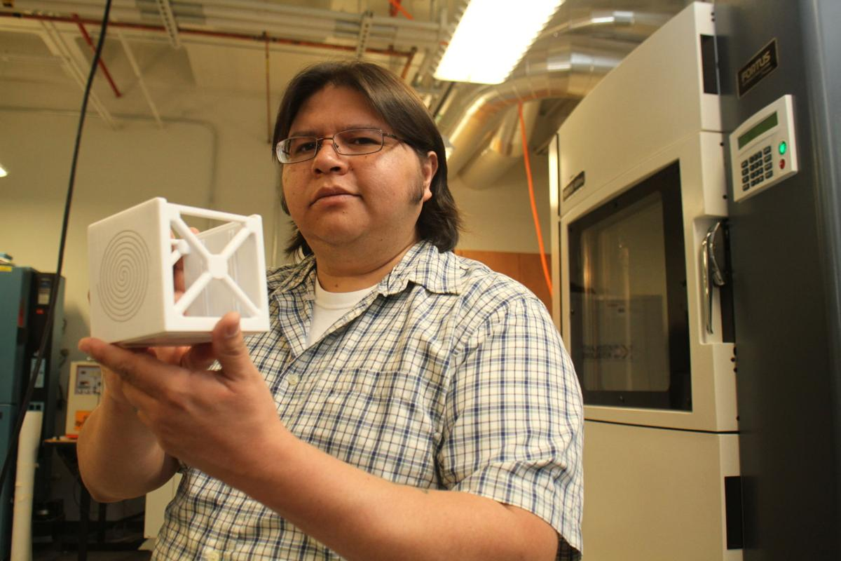
Student Testimonies #1: Dr. David Espalin
“The BD Seminar Series covered many topics that were beneficial to me in aspects of professional development and career expectations. Group discussions helped me set expectations for the mentor-protégé relationship, which then impacted the way I fostered and managed my relationship with my mentors and protégés. Discussions related to executing productive meetings have also been very beneficial as my time becomes scarce in the role of Assistant Professor. Lastly, the seminar exposed me to the variety of duties/roles that faculty must execute. This allowed me to take on some of those roles as a PhD student so that I was prepared after securing a faculty position. Overall, the BD Seminar Series enabled me to participate in discussions on topics that were not being discussed in any other part of my PhD curriculum. Through these seminars, I was better informed and prepared for post-PhD activities.” –
David Espalin, Ph.D. Mechanical Engineering

Slide 11
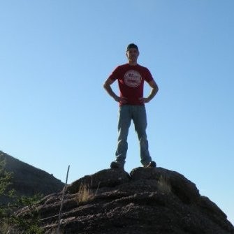
Student Testimonies #2: Dr. Frank Portillo
“The seminar was an overall success. Everything covered and practiced in the seminar had practical applications for our degrees and for jobs after graduation. Often, we the students gave talks about our research projects in this seminar, which greatly helped as practice for conferences or committee meetings. One of the experiences I found very helpful was our conference trip to Los Angeles. I was able to attend meetings, talks, and workshops that help me prepare for my dissertation proposal and qualifying exam. I appreciate all of the help I received during the BD seminar.” –
Francisco Portillo, Ph.D. Ecology and Evolutionary Biology

Slide 12
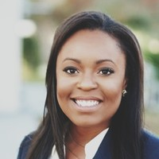
Student Testimony #3: Dr. Ngozi Ochoa
“The weekly BD Seminar was a fundamental part of the LSAMP BD Fellowship program. I looked forward to interacting with other doctoral students from various STEM disciplines and as an engineering student, I enjoyed learning about research topics from psychology, biology and chemistry. Through the seminar, we were provided a space where we were able to share our academic experiences, the struggles and successes, and this was an important aspect from which I gained great insight and developed comradery. In addition to this, I found the BD Seminar’s strong emphasis on professional development to be invaluable. The seminar served as a workshop where we were continuously encouraged to improve and enhance our presentation and writing skills. To engage with academic and industry professionals, guest speakers were invited to discuss issues such as tenure track, family/work balance, post-doctoral programs and pursuing careers in industry. I am privileged to have been an LSAMP BD Fellow;
the support of the program guided me through my Ph.D.,
prepared me well for after graduation and will continue
to have a great influence as I progress into my career.” –
Ngozi Ochoa, Ph.D. Materials Science and Engineering

Slide 13
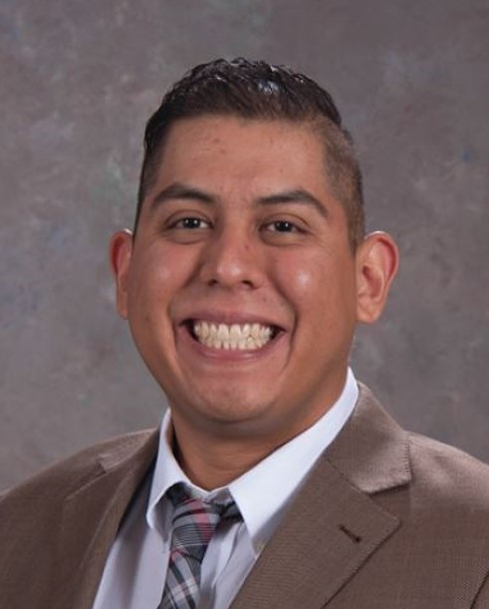
Student Testimony #4: Dr. Danniel Rodriguez
“Throughout my career, I regularly find myself implementing and relating to various items discussed in the BD Seminar Series. For example, the "1-minute Elevator Speech" was a concept introduced to me through the seminars and is a tool I regularly utilize while discussing research or business items with customers, colleagues and students. Another very useful item I learned from the BD Seminar is the concept: "Pillars of Professorship: Research, Teaching and Service“. This is an instrumental schematic that researchers and academics put into practice to structure career trajectories. In fact, throughout the time at my former position with the US Army Corps of Engineers, I actually found myself explaining this concept to fellow colleagues that were currently enrolled in PhD programs with other major universities. Just about all of them had never heard of the "Pillars of Professorship"; a concept I find to be critical for the aspiring researcher. Other highly useful soft skills were refined and learned from the BD Seminars, such as "How to write an email", "Research Collaboration," and "Proposal Writing."
The BD Seminar Series offers learning content that is very
relevant to the aspiring researcher and provides an
awareness of the necessary soft and technical
skills that are essential to a successful career.” –
Danniel Rodriguez, Ph.D. Civil Engineering

Slide 14
Conclusion
The BD Seminar Series contributes to the coachees’ success after entering the Ph.D. program in their chosen, STEM discipline.
The following design features of the seminar series seem to have a positive impact on Ph.D. student retention and can be replicated at similar campuses :
The seminar series provides a relaxed setting where coachees feel free, and are encouraged, to reflect on their academic experience.
The weekly intervention lasts for the first two years of the coachees’ Ph.D. program.
The small cohort size makes close monitoring feasible in order to offer additional individual student support where needed.
The seminar series provides a plethora of information about the academic research environment that is useful to all participants.

Slide 15
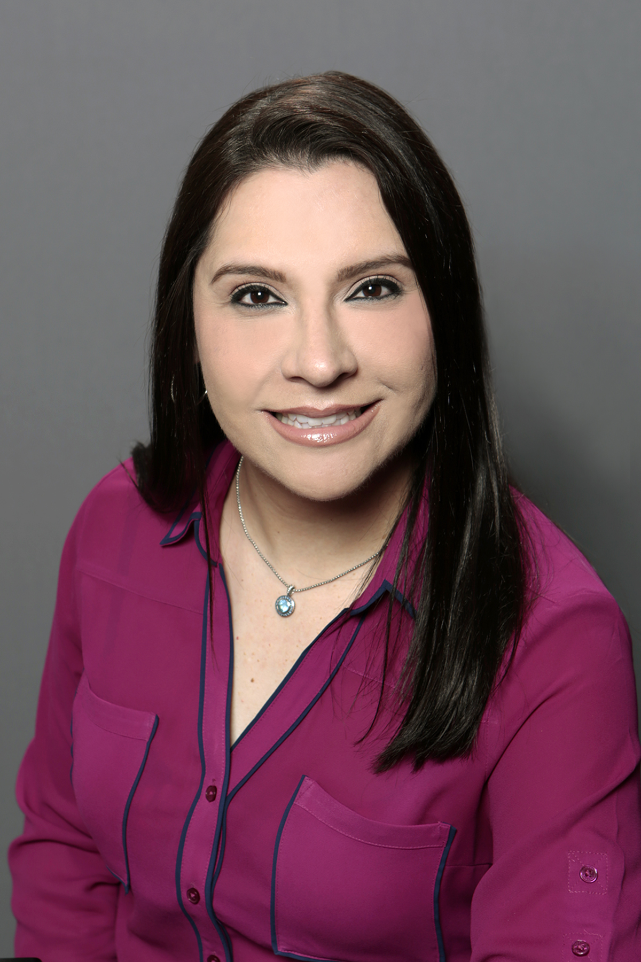
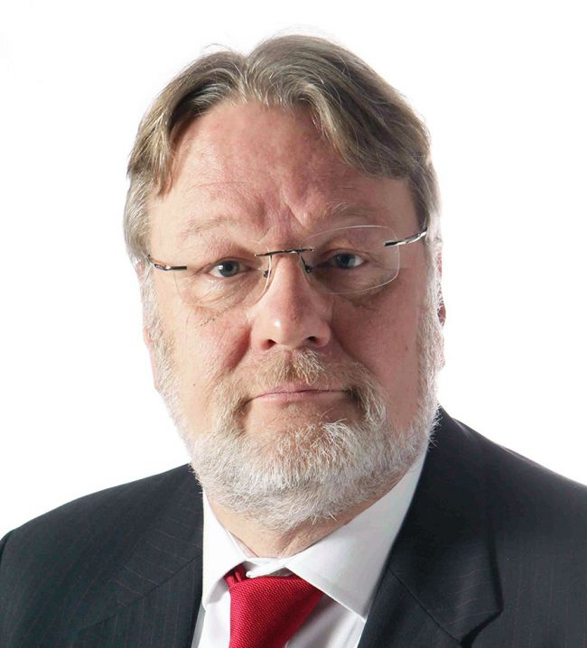
Contact Info
Ariana Arciero-Pino Helmut Knaust
avarcier@utep.edu hknaust@utep.edu

