Slide 1
Engaging STEM Doctoral Students: Group Mentoring on the Sidelines
Ariana Arciero, Benjamin Flores, Helmut Knaust
University of Texas LSAMP
Bridge to the Doctorate

Slide 2
What is the Bridge to the Doctorate (BD) project?
Funded by the National Science Foundation (NSF)
Began in 2003 as an initiative to support Louis Stokes Alliance for Minority Participation (LSAMP) alumni during their first two years of graduate studies
Available to national LSAMP alliances in Phase III or later
Two-year project that funds 12 STEM Ph.D. students:
Full tuition and fees
$32,000 / year stipend
Student Health Insurance
Professional development
High-quality mentorship
Institutional funding following 2-year BD tenure

Slide 3
What is the BD project?
Program Objectives
Recruit and select a cohort of highly-motivated and well-prepared BD Fellows
Induct BD Fellows into competitive research laboratories and projects
Provide a complete and relevant professional development program
Create a positive social environment with network and peer support
Provide rich, continuous mentoring experiences
Provide financial planning skills and security for the duration of doctoral studies

Slide 4
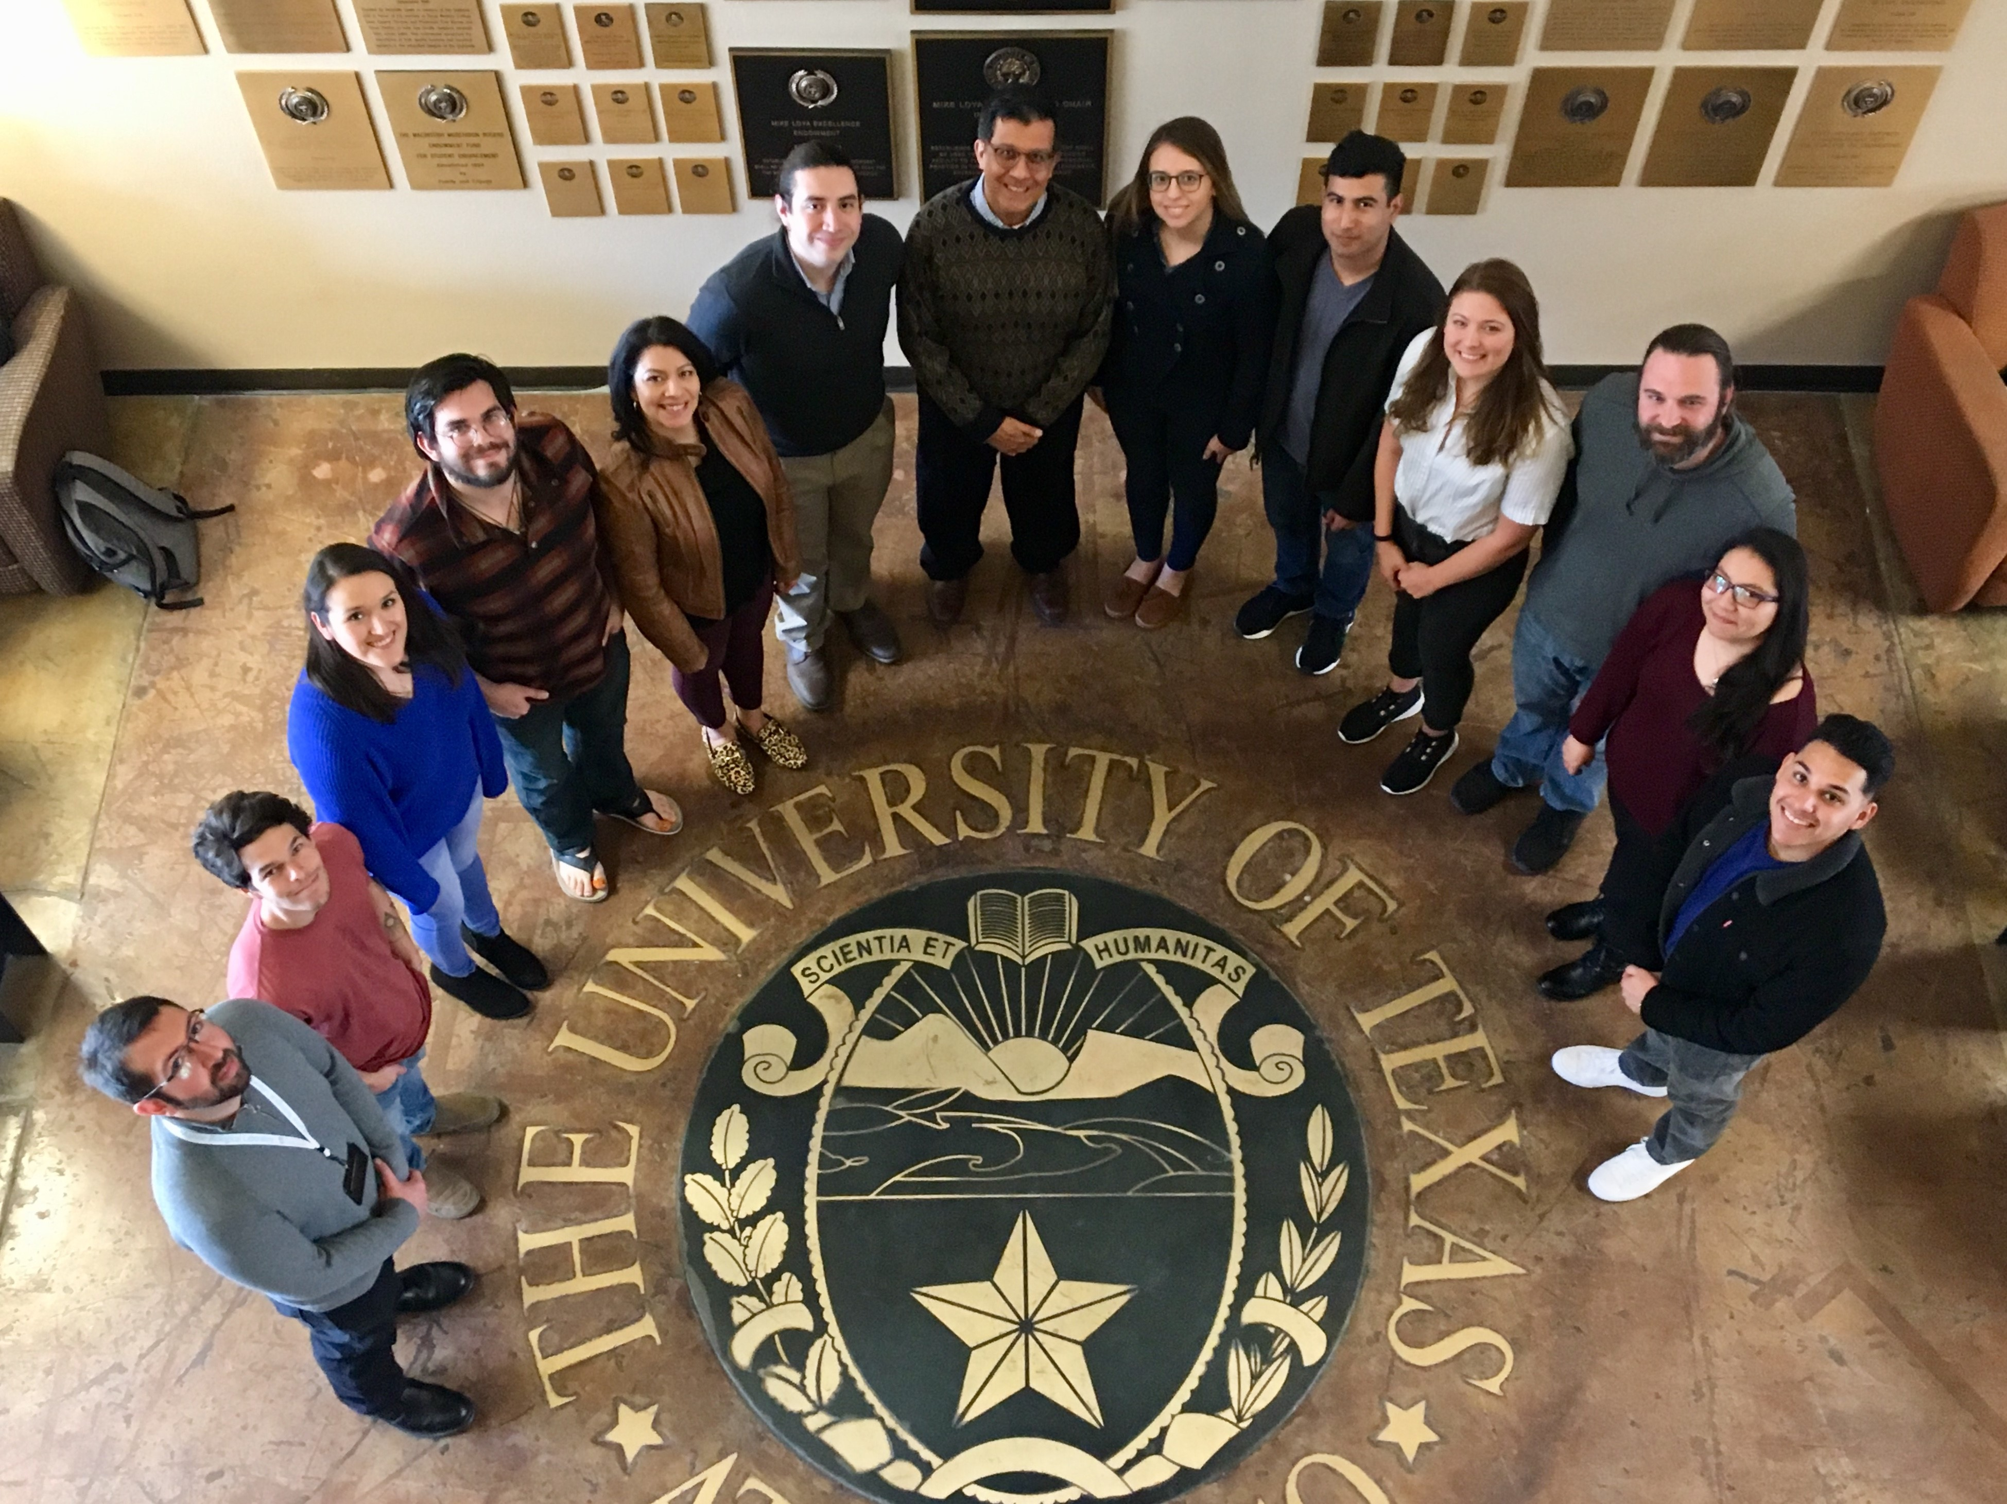
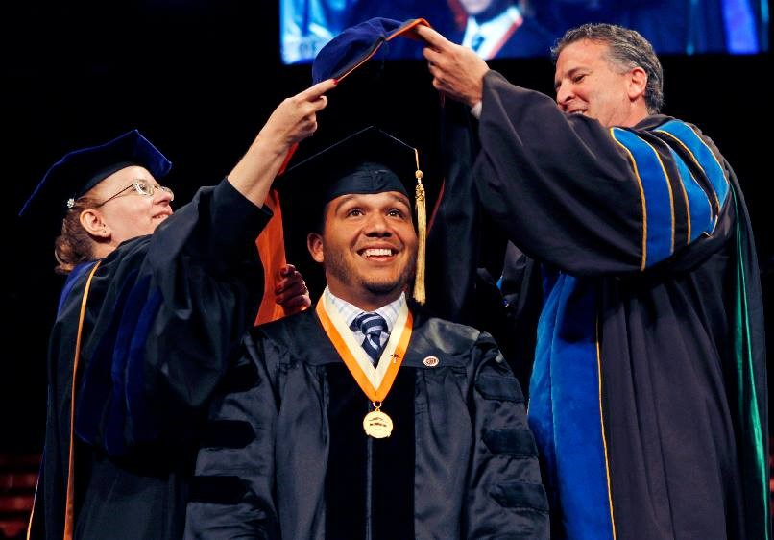
The BD Project in the UT System
Campus | BD Award Years
UT El Paso | 2003, 2005, 2008, 2009, 2011, 2013, 2018, 2022
UT Rio Grande Valley | 2004
UT Arlington | 2010, 2014
UT San Antonio | 2012

Slide 5
What do Doctoral Students Need to Graduate?
Main Factors that Contribute to the Ability to Complete Doctoral Degrees
(CGS Ph.D. Completion Project Survey, N=1,406):
MAIN CONTRIBUTING FACTORS | % RESPONDENTS
1. Financial Support | 80
2. Mentoring/Advising | 65
3. Family | 57
4. Social Environment/ Peer Group Support | 40
5. Program Quality | 36
6. Professional/Career Guidance | 29
7. Program Requirements | 22
8. Personal Circumstances | 18
9. Other | 11

Slide 6
Operational Definition of Mentoring
Holistic mentoring is a multifaceted, reciprocal, and conscious relationship in which a mentor engages a protégé or group of protégés from diverse backgrounds to advance their goals and to learn from their professional development experiences.
In addition to guiding the discovery of intellectual passions, providing advice and access to resources, and advocating for their protégés, holistic mentors readily acknowledge their protégés identity, validate their backgrounds and accomplishments, and provide supportive environments to prevent isolation by promoting cultural awareness and sensitivity.
Mentors and protégés work together toward a better future by engaging each other in a virtuous cycle of learning and holistic growth of the individual.

Slide 7
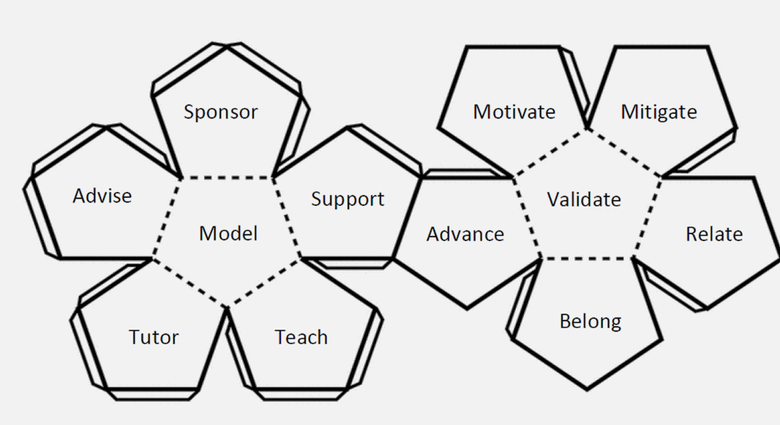
Facets of Mentoring
7
8
1
12
11
9
5
2
6
10
4
3

Slide 8
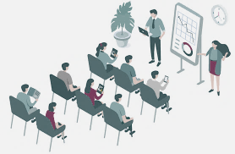
The BD Seminar
4 semesters - 1 hour per week
Professional Development Curriculum
Research abstract
Research presentations (updates)
On-campus laboratory tours
Teaching Philosophy Statement
Research statement and plan
One-minute elevator speech
Three-minute thesis
Publish and flourish workshop
Mental Health workshop
Intersectionality workshop
Other
Service Component
UT System LSAMP Conference panel
UT System LSAMP Conference research poster judging

Slide 9
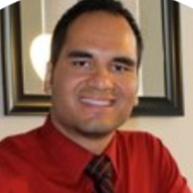
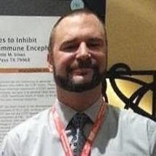
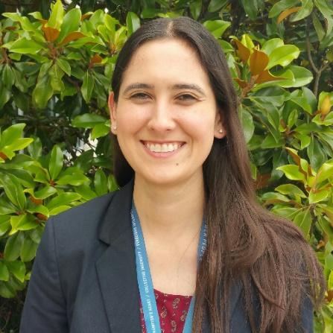
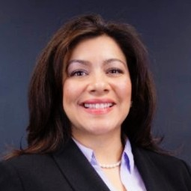
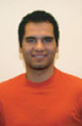
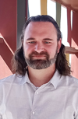
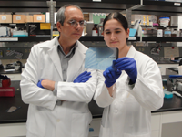
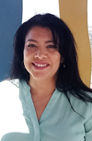
Success Stories I
Dr. Marcos Bolanos, ECE,
FAA
Dr. Colin Knight,
Biology,
NIH
Dr. Angelica Lopez,
Biology,
DTRA
Dr. Arlene Smith,
MASE,
AFRL

Slide 10
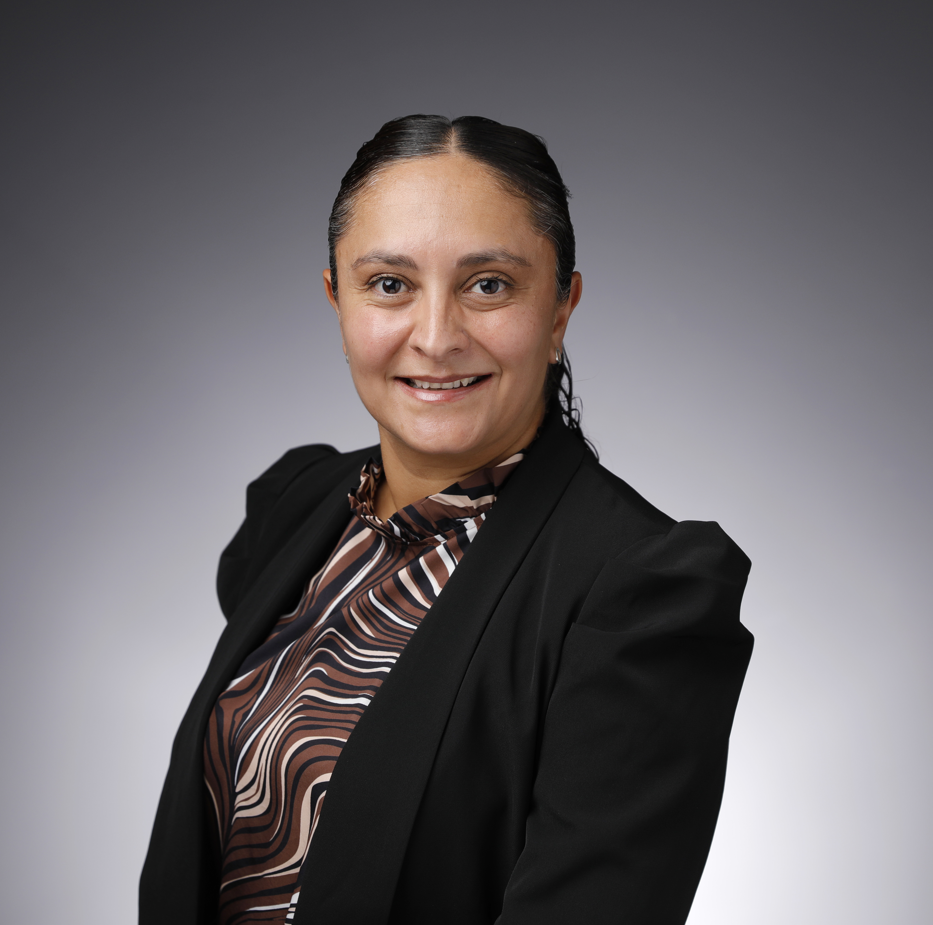
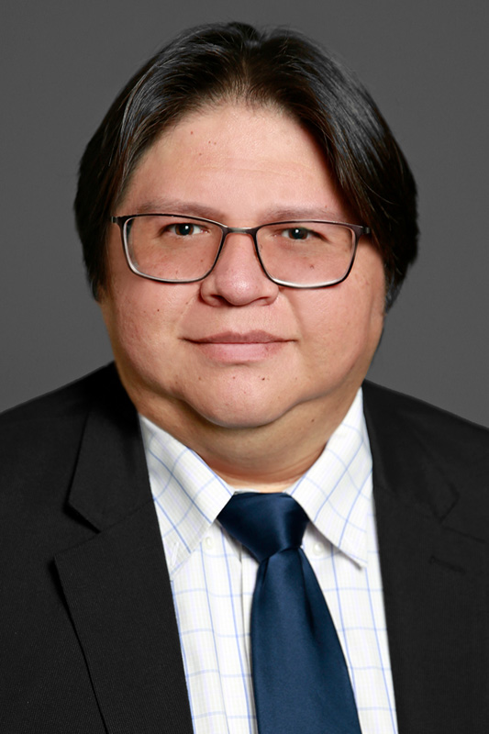
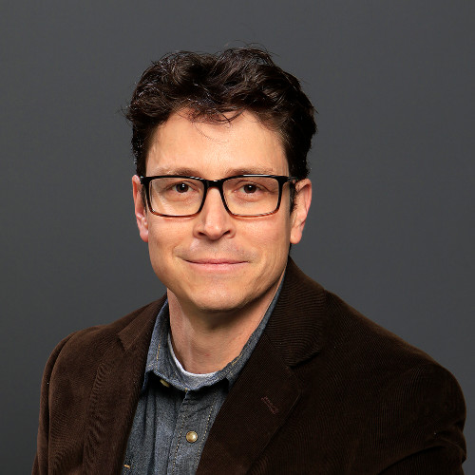
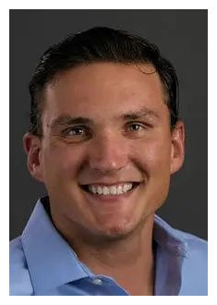
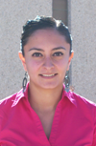
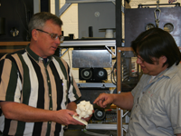
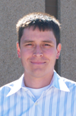
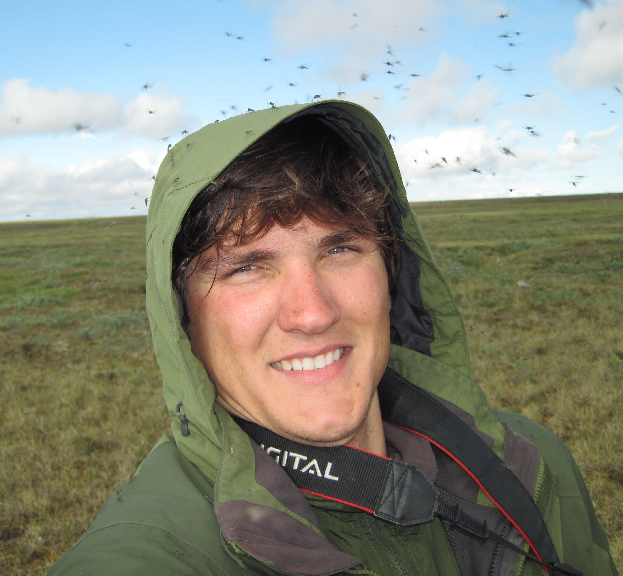
Success Stories II
Dr. Aryzbe Najera,
UTEP ECE Dept.
Dr. David Espalin,
UTEP AME Dept.
Dr. David Roberson,
UTEP MMBE Dept.
Dr. Cristian Andresen,
UW-Madison, Geography

Slide 11
Lessons Learned
Mentoring projects with a professional development component enrich the graduate student experience and allow for close monitoring of degree advancement.
Milestone celebrations are an integral component of programming.
Formative assessment provides opportunity for periodic program improvements.
Program staff must be prepared to mitigate negative experiences when mentor/protégé relationships go awry.
Mental health awareness, coaching, and resources humanize the graduate student experience.
It takes a village: joint efforts coalesce people’s assets that improve the graduate student experience.

Slide 12
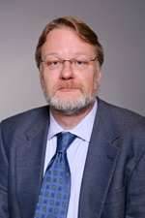
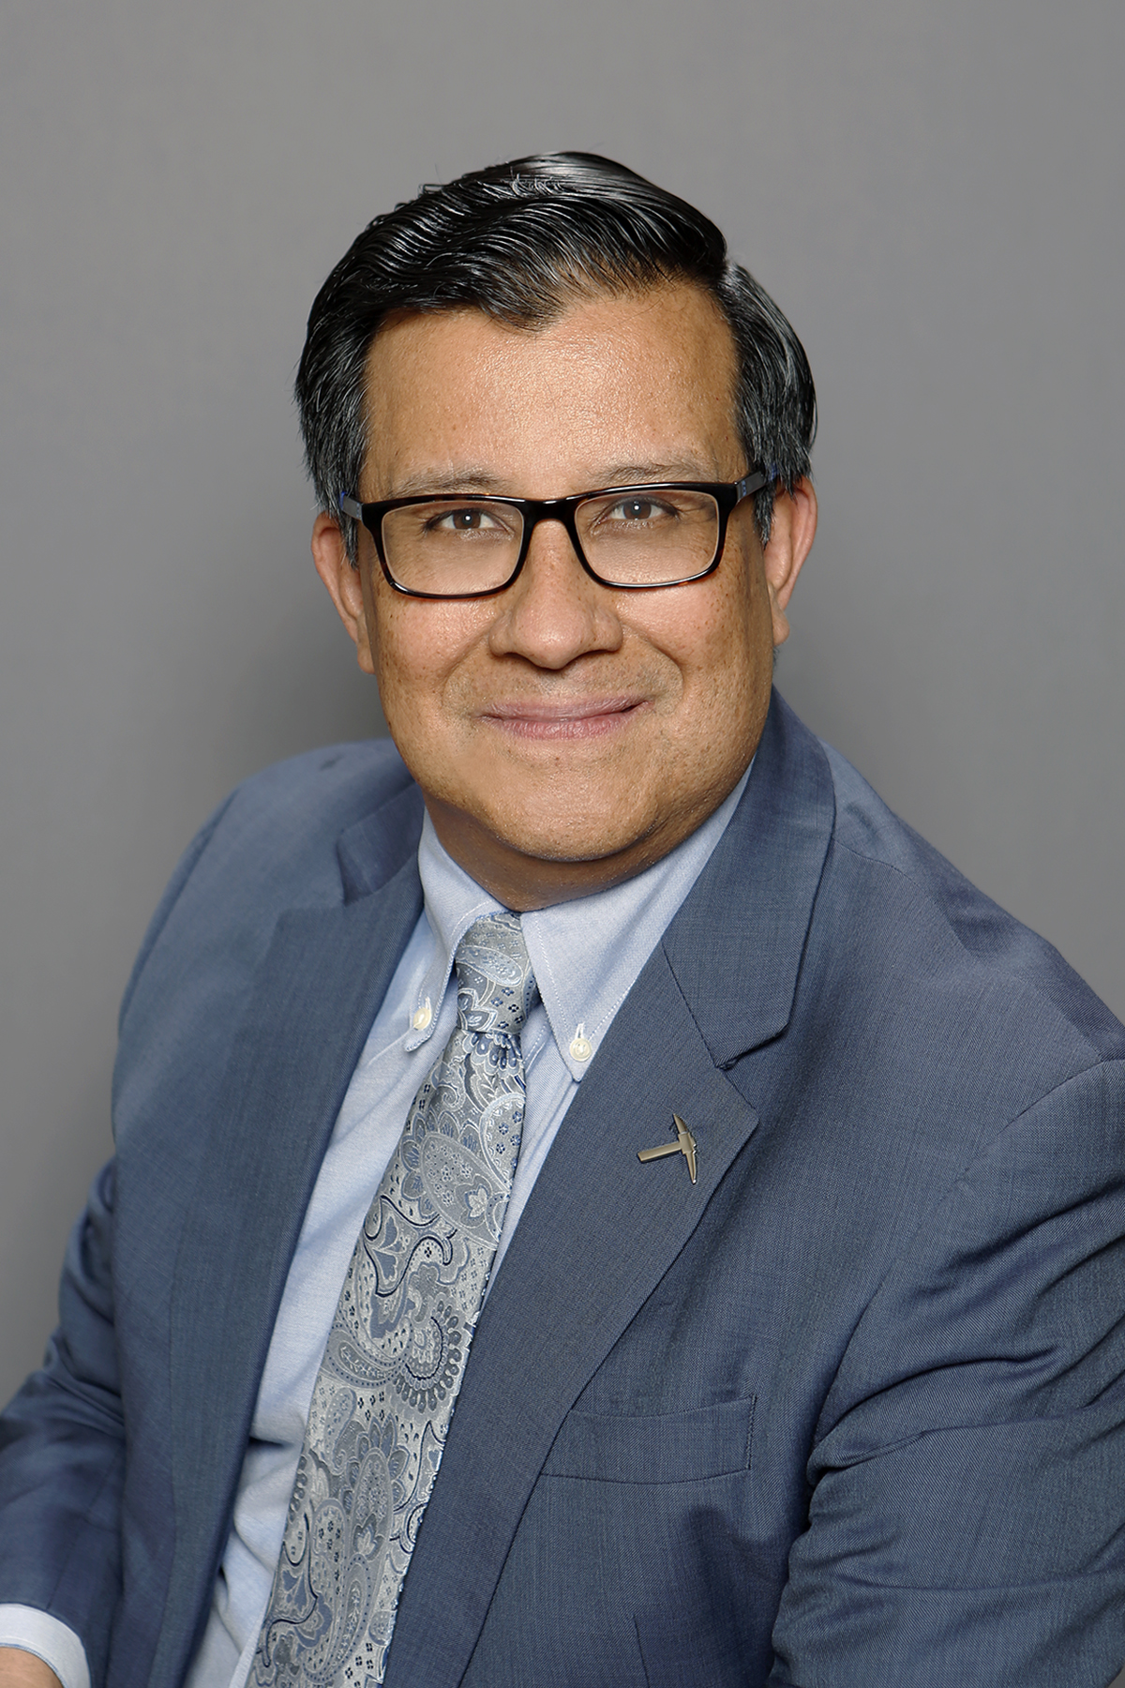
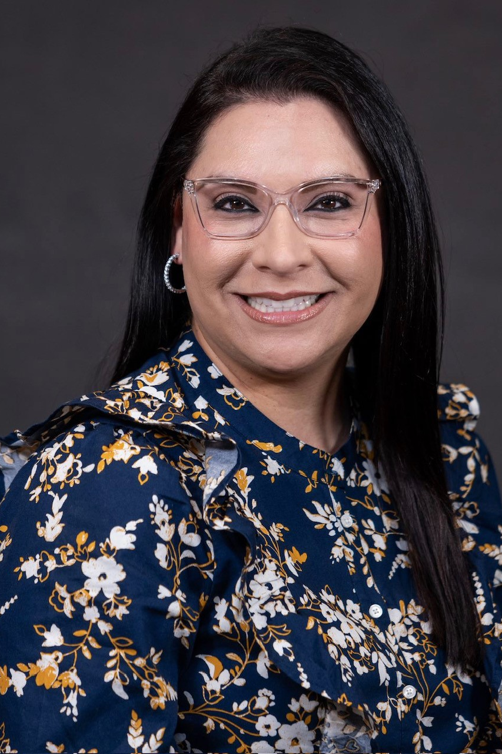
Contact us
hknaust@utep.edu
bflores@utep.edu
avarcier@utep.edu
UT System Louis Stokes Alliance for Minority Participation:
https://www.utep.edu/engineering/lsamp/

